Slide 1
Sibling Color Wheel
by the Sibling Support Program
Created by Emily Rubin, LICSW © 2025. Do not modify without permission.
Notes:
Introductions: Ask siblings to share their name, age, preferred pronouns, and favorite color.
Ask the group: “Does everyone know why they are in this group?” and ask siblings to explain.
(“Everyone is here today because they have a sibling with challenges. We know it can be hard to grow up with a sibling that has mental health or behavioral problems.”)
Tell siblings that right now, their parents/guardians are in a separate Zoom group to learn about how to support siblings.
Go to next slide.

Slide 2
Group Rules
This is a safe place.
We respect each other.
Please keep your camera on so we can see each other.
It’s OK to use the chat function but please do so appropriately.
What is said in this group stays in this group.*
Notes:
Ask siblings to take turns reading the rules.
Ask, “What do you think it means that this is a safe place?”
(Be respectful and nonjudgmental, we support each other, etc.)
Tell the siblings they can participate as much as they like and they can always say “pass.”
Ask, “What does it mean that ‘what is said in this group stays in this group’?”
* The only exception is safety-related. We want to make sure that everyone is safe at home and sometimes a family member might need some extra help.

Slide 3
Getting to Know Each Other in 5 Minutes…
What kind of music do you like?
Notes:
Tell the siblings, “Before we start today’s activity, let’s get to know each other a little bit.”
Ask for a volunteer to read the question that appears after you click the Return button.
Note to facilitators:
You need to click Return for the question to appear.
Try to only spend 5 minutes on this slide so there is time for the group activity.

Slide 4
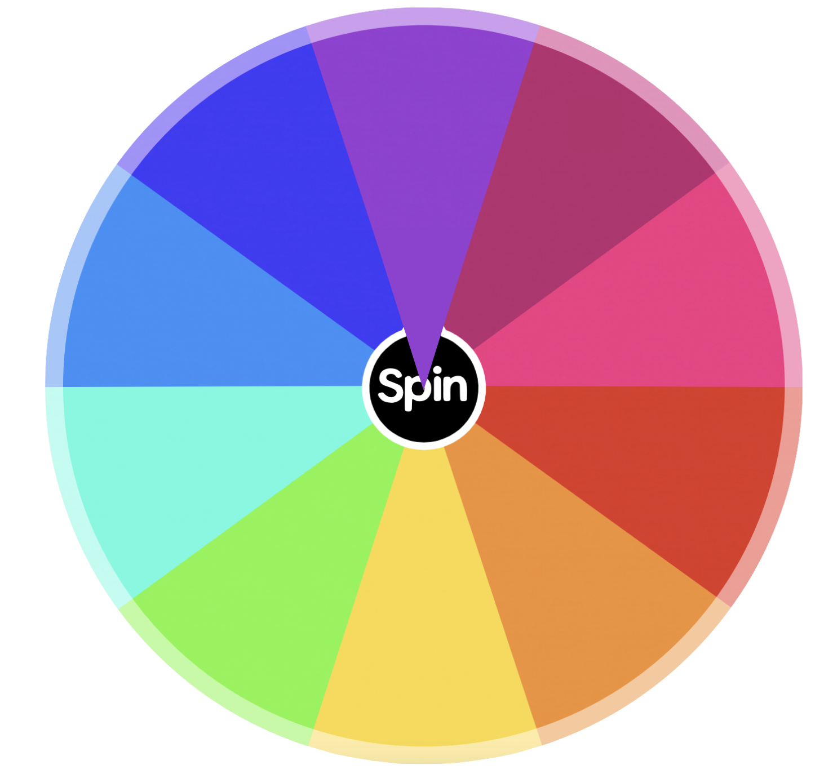


Spin the Wheel
Wrap-Up
Notes:
Tell the siblings, “Today we are going to do an activity where we spin the color wheel and then discuss the questions that appear.”
Tell the siblings, “We will also be talking about coping skills today. Before we get started, would someone define the term ‘coping skills’?” (Things we can do to manage difficult situations.)
Notes to facilitators:
Click on the Spin icon to trigger the spinning animation. Click twice more on the Spin button for the color-coded question to appear.
When the question has been answered, click on the Home button on the lower right corner to return to the color wheel.
When the activity is over (when all prompts have been selected or before time runs out), click “Wrap-Up” to be brought to the slide on coping skills.
Reminder to take opportunities to validate sibling experiences and identify coping skills throughout the activity.

Slide 5

Who are the most supportive people in your life?
Notes:
Building Self-Esteem Question
Ask a sibling to read the question out loud. Ask if any sibs would like to share. Encourage the sibs to talk to each other when possible.
If needed, prompts for discussion:
What does it mean to support someone? Can you support people in different ways?
Describe a time you supported your sibling. How did it feel to do that?
Does your sibling support you? If so, how do they show their support? If not, how does that make you feel?
Why do we support other people?
Reminder to take opportunities to validate sibling experiences and identify coping skills.
Click on the home icon to return to the game slide.

Slide 6
Color Wheel
Wrap-Up
Notes:
Notes to facilitators:
Click on the Spin icon to trigger the spinning animation. Click twice more on the Spin button for the color-coded question to appear.
When the question has been answered, click on the Home button on the lower right corner to return to the color wheel.
When the activity is over (when all prompts have been selected or before time runs out), click “Wrap-Up” to be brought to the slide on coping skills.
Reminder to take opportunities to validate sibling experiences and identify coping skills throughout the activity.

Slide 7
Do you ever worry that your sibling might hurt themself?
Notes:
Safety Question
Ask a sibling to read the question out loud. Ask if any sibs would like to share. Encourage the sibs to talk to each other when possible.
If needed, prompts for discussion:
Why might a person hurt themself on purpose?* (They may be frustrated, want to relieve inner pain, get attention, or experiment)
Do you ever worry that your sibling might hurt someone else? Please explain.
Does your sibling think it’s fun or funny to hurt people? Please explain.
*Discussion prompt 2 can be difficult for young siblings to comprehend. Use simple language.
Reminder to take opportunities to validate sibling experiences and identify coping skills.
Click on the home icon to return to the game slide.

Slide 8
Color Wheel
Wrap-Up
Notes:
Notes to facilitators:
Click on the Spin icon to trigger the spinning animation. Click twice more on the Spin button for the color-coded question to appear.
When the question has been answered, click on the Home button on the lower right corner to return to the color wheel.
When the activity is over (when all prompts have been selected or before time runs out), click “Wrap-Up” to be brought to the slide on coping skills.
Reminder to take opportunities to validate sibling experiences and identify coping skills throughout the activity.

Slide 9
When your sibling gets upset, do you try to help them
or is it better to let an adult deal with it?
Notes:
Sibling Anxiety Question
Ask a sibling to read the question out loud. Ask if any sibs would like to share. Encourage the sibs to talk to each other when possible.
If needed, prompts for discussion:
Describe a time your sibling was upset. What happened?
How do your parents/guardians react when your sibling is upset? Do they have ways to calm them down?
What advice would you give your sibling when they are upset?
Does seeing your sibling upset make you feel upset? Please explain.
Reminder to take opportunities to validate sibling experiences and identify coping skills.
Click on the home icon to return to the game slide.

Slide 10
Color Wheel
Wrap-Up
Notes:
Notes to facilitators:
Click on the Spin icon to trigger the spinning animation. Click twice more on the Spin button for the color-coded question to appear.
When the question has been answered, click on the Home button on the lower right corner to return to the color wheel.
When the activity is over (when all prompts have been selected or before time runs out), click “Wrap-Up” to be brought to the slide on coping skills.
Reminder to take opportunities to validate sibling experiences and identify coping skills throughout the activity.

Slide 11
Who protects you in your family?
Notes:
Sibling Aggression Question
Ask a sibling to read the question out loud. Ask if any sibs would like to share. Encourage the sibs to talk to each other when possible.
If needed, prompts for discussion:
Describe a time when a family member protected you. How did you feel?
Was there ever a time you didn’t feel safe or protected? What happened?
Sometimes protection can mean standing up for someone. Have you ever stood up for your sibling?
Do you feel safe being alone with your sibling?
Reminder to take opportunities to validate sibling experiences and identify coping skills.
Click on the home icon to return to the game slide.

Slide 12
Color Wheel
Wrap-Up
Notes:
Notes to facilitators:
Click on the Spin icon to trigger the spinning animation. Click twice more on the Spin button for the color-coded question to appear.
When the question has been answered, click on the Home button on the lower right corner to return to the color wheel.
When the activity is over (when all prompts have been selected or before time runs out), click “Wrap-Up” to be brought to the slide on coping skills.
Reminder to take opportunities to validate sibling experiences and identify coping skills throughout the activity.

Slide 13
Is it OK to keep secrets within a family?
Notes:
Family Rules Question
Ask a sibling to read the question out loud. Ask if any sibs would like to share. Encourage the sibs to talk to each other when possible.
If needed, prompts for discussion:
Do you think your parents/guardians should make a family rule that no one can keep secrets? Why or why not?
Was there ever a time you kept a secret from your family? How did you feel about that?
Does your sibling ask you to keep secrets? Please explain.
Sometimes people keep secrets to prevent someone else from being upset or getting their feelings hurt. Do you think that is OK? Please explain.
Reminder to take opportunities to validate sibling experiences and identify coping skills.
Click on the home icon to return to the game slide.

Slide 14
Color Wheel
Wrap-Up
Notes:
Notes to facilitators:
Click on the Spin icon to trigger the spinning animation. Click twice more on the Spin button for the color-coded question to appear.
When the question has been answered, click on the Home button on the lower right corner to return to the color wheel.
When the activity is over (when all prompts have been selected or before time runs out), click “Wrap-Up” to be brought to the slide on coping skills.
Reminder to take opportunities to validate sibling experiences and identify coping skills throughout the activity.

Slide 15
Do you agree or disagree when people say,
“Life isn't fair”?
Notes:
Fair is Not Equal Question
Ask a sibling to read the question out loud. Ask if any sibs would like to share. Encourage the sibs to talk to each other when possible.
If needed, prompts for discussion:
Describe a time you felt like life wasn’t fair.
Does it feel unfair to have a sibling with behavioral issues? If so, how do you cope with that?
Is it fair if your parents spend more time with your sibling than with you? Why or why not?
Reminder to take opportunities to validate sibling experiences and identify coping skills.
Click on the home icon to return to the game slide.

Slide 16
Color Wheel
Wrap-Up
Notes:
Notes to facilitators:
Click on the Spin icon to trigger the spinning animation. Click twice more on the Spin button for the color-coded question to appear.
When the question has been answered, click on the Home button on the lower right corner to return to the color wheel.
When the activity is over (when all prompts have been selected or before time runs out), click “Wrap-Up” to be brought to the slide on coping skills.
Reminder to take opportunities to validate sibling experiences and identify coping skills throughout the activity.

Slide 17
Do you ever wish you were part of someone else’s family? Why or why not?
Notes:
Sibling Guilt Question
Ask a sibling to read the question out loud. Ask if any sibs would like to share. Encourage the sibs to talk to each other when possible.
If needed, prompts for discussion:
Do you ever feel guilty when you are with your sibling? Please explain.
Is feeling guilty a good thing or a bad thing? Please explain.
Is being part of a family important? Why or why not?
Reminder to take opportunities to validate sibling experiences and identify coping skills.
Click on the home icon to return to the game slide.

Slide 18
Color Wheel
Wrap-Up
Notes:
Notes to facilitators:
Click on the Spin icon to trigger the spinning animation. Click twice more on the Spin button for the color-coded question to appear.
When the question has been answered, click on the Home button on the lower right corner to return to the color wheel.
When the activity is over (when all prompts have been selected or before time runs out), click “Wrap-Up” to be brought to the slide on coping skills.
Reminder to take opportunities to validate sibling experiences and identify coping skills throughout the activity.

Slide 19
What is the difference between being alone and feeling lonely?
Notes:
Mindfulness Question
Ask a sibling to read the question out loud. Ask if any sibs would like to share. Encourage the sibs to talk to each other when possible.
If needed, prompts for discussion:
Describe a time you felt lonely. What was it like? How did you cope with it?
Do you like spending time alone? Why or why not?
Does spending time with your sibling help you feel less lonely or more lonely? Please explain.
Do you think your sibling gets lonely? What advice would you give them if they felt this way?
Reminder to take opportunities to validate sibling experiences and identify coping skills.
Click on the home icon to return to the game slide.

Slide 20
Color Wheel
Wrap-Up
Notes:
Notes to facilitators:
Click on the Spin icon to trigger the spinning animation. Click twice more on the Spin button for the color-coded question to appear.
When the question has been answered, click on the Home button on the lower right corner to return to the color wheel.
When the activity is over (when all prompts have been selected or before time runs out), click “Wrap-Up” to be brought to the slide on coping skills.
Reminder to take opportunities to validate sibling experiences and identify coping skills throughout the activity.

Slide 21
When was a time your sibling upset you?
Notes:
Love/Hate Relationship Question
Ask a sibling to read the question out loud. Ask if any sibs would like to share. Encourage the sibs to talk to each other when possible.
If needed, prompts for discussion:
When your sibling gets upset, how do they behave? Do you behave the same way when you are upset? Please explain.
How do you calm down when your sibling upsets you?
Do all siblings get into fights? Do you know any siblings that never get mad at each other?
Reminder to take opportunities to validate sibling experiences and identify coping skills.
Click on the home icon to return to the game slide.

Slide 22
Color Wheel
Wrap-Up
Notes:
Notes to facilitators:
Click on the Spin icon to trigger the spinning animation. Click twice more on the Spin button for the color-coded question to appear.
When the question has been answered, click on the Home button on the lower right corner to return to the color wheel.
When the activity is over (when all prompts have been selected or before time runs out), click “Wrap-Up” to be brought to the slide on coping skills.
Reminder to take opportunities to validate sibling experiences and identify coping skills throughout the activity.

Slide 23
Do you feel you can talk openly with other people
about your sibling? Why or why not?
Notes:
Shame/Embarrassment Question
Ask a sibling to read the question out loud. Ask if any sibs would like to share. Encourage the sibs to talk to each other when possible.
If needed, prompts for discussion:
Do you ever feel embarrassed about your sibling? Please explain.
Do your friends ask questions about your sibling? If so, what do they ask?
Do you have any friends who also have a sibling with behavioral problems? If so, do you feel comfortable talking to them about it?
Are there any adults you feel comfortable talking to about your sibling?
Reminder to take opportunities to validate sibling experiences and identify coping skills.
Click on the home icon to return to the game slide.

Slide 24
Coping Skills: What Works for You?
Take deep breaths (breathe from your belly, not your chest)
Move your body (take a walk, stretch, exercise)
Read a good book
Watch a funny movie
Snuggle or play with a pet
Hug a stuffed animal or pillow
Take a bath or hot shower
Rip paper into small pieces
Write a letter to someone that you may never send
Journal (write about what you are struggling with)
Count to 10 slowly
Get a drink of water
Call an adult or friend
Draw or color
Listen to or play music
Walk away
Notes:
Tell the group, “We talked about coping skills in today’s group.”
Ask siblings to share the coping strategies that work for them.
Next, tell the group, “Now we want to share a list of coping skills that other siblings have told us about.”
The coping skills will appear one at a time when you hit the space bar.
Ask the group:
What coping skills have you tried that work for you?
What coping skills would you like to try after today’s group?
Are there any coping skills you use that aren’t on this list?
Go to next slide to wrap up the group.

Slide 25
Wrapping Up
What was your favorite part of today’s group?
What would you change to make the group better?
Notes:
Ask the siblings the questions on the slide. Allow them to respond verbally or in the chat feature. Record the responses.
Let the siblings know when the group will meet again and that they are always welcome to return.
Finally, remind siblings to complete the survey that we are sending to their parent/guardian’s email.
Tell them, “Your responses are important to us and help us improve the group!”
Thank the siblings for participating.

