Slide 1
Pieces of My Puzzle
by the Sibling Support Program
Created by Emily Rubin, LICSW © 2025. Do not modify without permission.
Notes:
Introductions: Ask siblings to share their name, age, preferred pronouns, and favorite color.
Ask the group: “Does everyone know why they are in this group?” and ask siblings to explain.
(“Everyone is here today because they have a sibling with challenges. We know it can be hard to grow up with a sibling that has mental health or behavioral problems.”)
Tell siblings that right now, their parents/guardians are in a separate Zoom group to learn about how to support siblings.
Go to next slide.

Slide 2
Group Rules
This is a safe place.
We respect each other.
Please keep your camera on so we can see each other.
It’s OK to use the chat function but please do so appropriately.
What is said in this group stays in this group.*
Notes:
Ask siblings to take turns reading the rules.
Ask, “What do you think it means that this is a safe place?”
(Be respectful and nonjudgmental, we support each other, etc.)
Tell the siblings they can participate as much as they like and they can always say “pass.”
Ask, “What does it mean that ‘what is said in this group stays in this group’?”
* The only exception is safety-related. We want to make sure that everyone is safe at home and sometimes a family member might need some extra help.

Slide 3
Getting to Know Each Other in 5 Minutes…
What is your favorite animal?
Notes:
Tell the siblings, “Before we start today’s activity, let’s get to know each other a little bit.”
Ask for a volunteer to read the question that appears after you click the Return button.
Note to facilitators:
1. You need to click Return for the question to appear.
2. Try to only spend 5 minutes on this slide so there is time for the group activity.

Slide 4
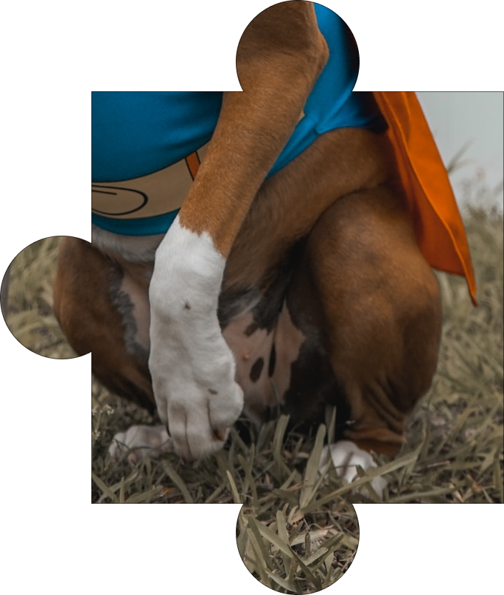
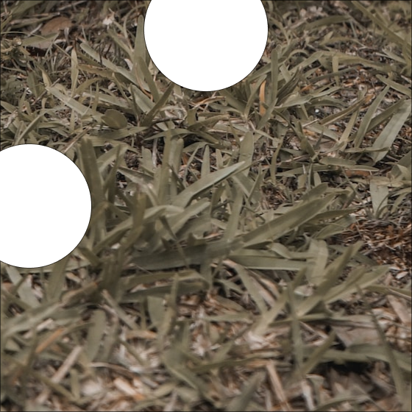


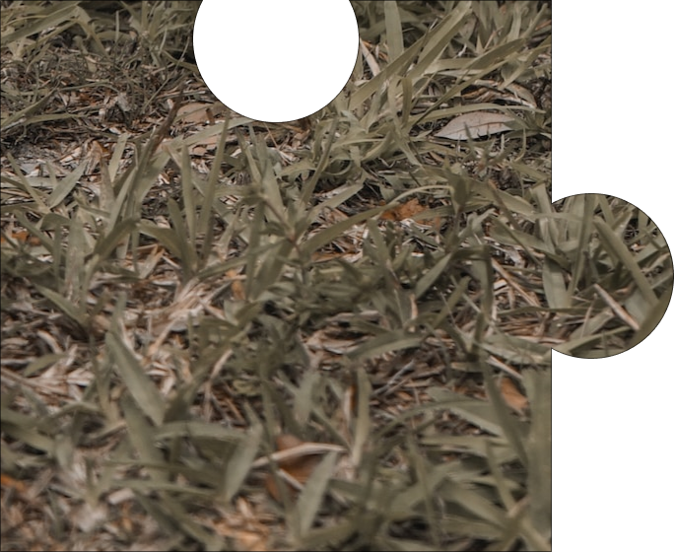
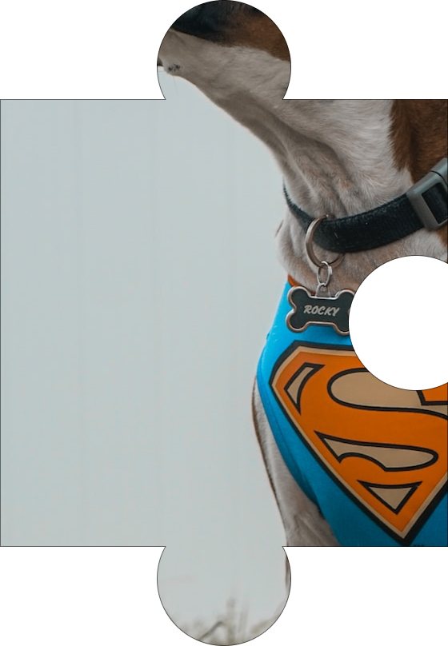
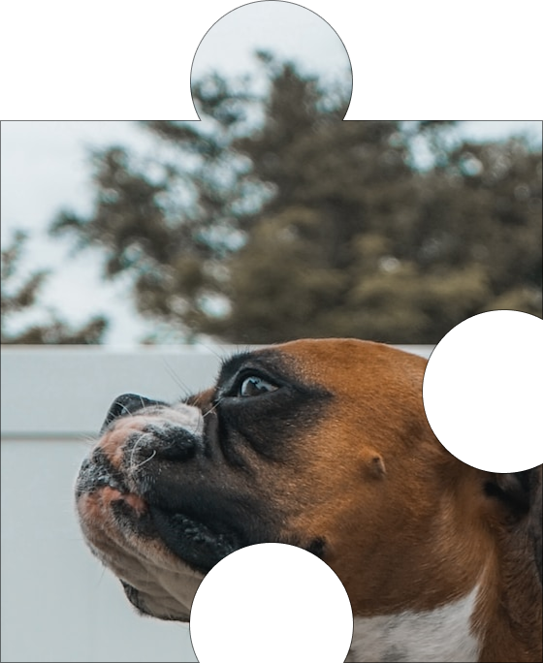
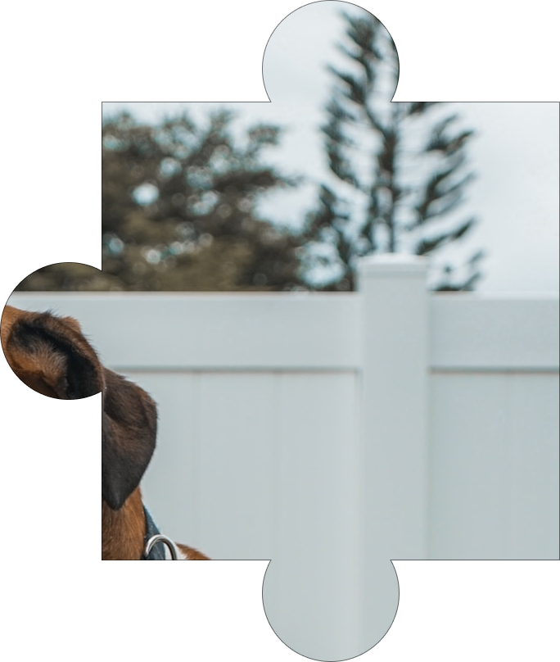
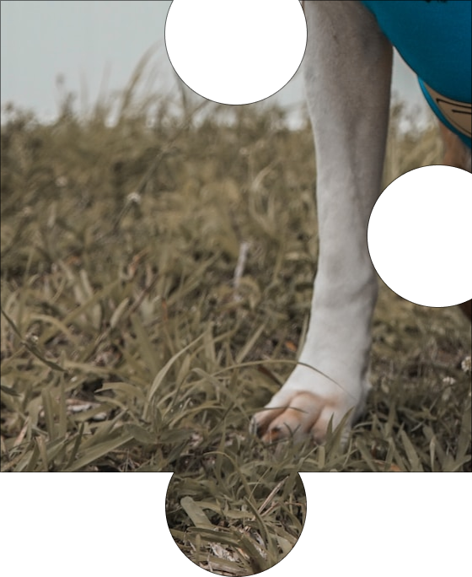
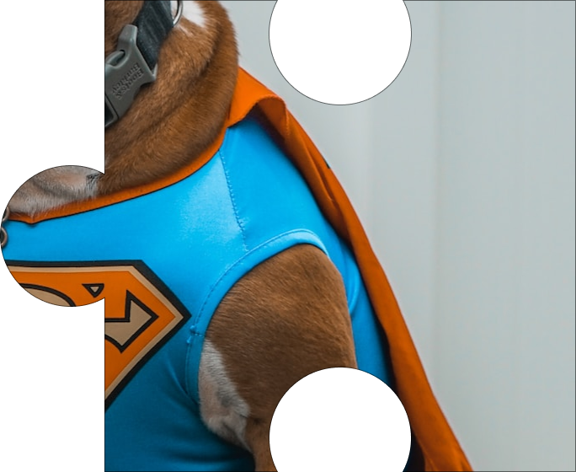
Choose a Puzzle Piece
1
2
3
4
5
6
7
8
9
10
Wrap-Up
Notes:
Tell the siblings, “Today we are going to do an activity where siblings take turns choosing a puzzle piece, and then we discuss the question that appears. At the end of the group, we will see what the puzzle looks like when all the pieces are put together.”
Tell the siblings, “We will also be talking about coping skills today. Before we get started, would someone define the term ‘coping skills’?” (Things we can do to manage difficult situations.)
Notes to facilitators:
When the activity is over (when all prompts have been selected or before time runs out), click “Wrap-Up” to be brought to the completed puzzle. Next, click Return to go to the slide on coping skills.
Reminder to take opportunities to validate sibling experiences and identify coping skills throughout the activity.

Slide 5

Does anything annoy you about your sibling? Is there anything you admire about your sibling?
Notes:
Love/Hate Relationship Question
Ask a sibling to read the question out loud. Ask if any sibs would like to share. Encourage the sibs to talk to each other when possible.
If needed, prompts for discussion:
Does your sibling have any qualities you like? If so, what are they?
Is there anything you like to do with your sibling? If so, what is it?
Do you get annoyed if you spend too much time with your sibling?
Are you comfortable telling your sibling when you need some time alone? Why or why not?
Is it better if there is an adult present when you spend time together?
Reminder to take opportunities to validate sibling experiences and identify coping skills throughout the activity.
Click on the home icon to return to the game slide.

Slide 6
My sibling is very sensitive to the way food smeIls. They are allowed to eat cereal for dinner, but I have to eat the meal that is served. Is that fair?
Notes:
Fair is Not Equal Question
Ask a sibling to read the question out loud. Ask if any sibs would like to share. Encourage the sibs to talk to each other when possible.
If needed, prompts for discussion:
Does your sibling have trouble with certain sensory things? (ex: the way certain clothes feel on their skin, the way certain foods smell or taste, getting scared from loud noises, etc.) If so, what do you think about that?
Do you often feel like your parents treat you differently than your sibling? If so, how does that make you feel?
Do you and your sibling have to follow different rules? Please give an example. How does it make you feel?
How do you deal with the frustration when something doesn’t feel fair between you and your sibling?
Reminder to take opportunities to validate sibling experiences and identify coping skills throughout the activity.
Click on the home icon to return to the game slide.

Slide 7
Which is worse: being called names or being punched? Why?
Notes:
Sibling Aggression Question
Ask a sibling to read the question out loud. Ask if any sibs would like to share. Encourage the sibs to talk to each other when possible.
If needed, prompts for discussion:
Describe a time you got hurt physically. How did it make you feel, and how did you deal with it?
Describe a time when someone hurt your feelings. How did it make you feel, and how did you deal with it?
Do you have an adult that you feel comfortable talking to when you get hurt? If so, who is it?
What is the difference between getting hurt physically and getting hurt emotionally?
Reminder to take opportunities to validate sibling experiences and identify coping skills throughout the activity.
Click on the home icon to return to the game slide.

Slide 8
Does home feel like a safe place for you? Why or why not?
Notes:
Safety Question
Ask a sibling to read the question out loud. Ask if any sibs would like to share. Encourage the sibs to talk to each other when possible.
If needed, prompts for discussion:
Do you ever feel unsafe around your sibling? What kinds of things do they do to make you feel that way?
How do you cope with feeling unsafe around your sibling?
Would anything help you feel safer at home? If so, what would that be?
What helps you feel safe?
What is the difference between physical safety and emotional safety?
What will you do to make sure you have a safe home when you are an adult?
Reminder to take opportunities to validate sibling experiences and identify coping skills throughout the activity.
Click on the home icon to return to the game slide.

Slide 9
Is it better to be the oldest, youngest, or middle child?
Notes:
Family Rules Question
Ask a sibling to read the question out loud. Ask if any sibs would like to share. Encourage the sibs to talk to each other when possible.
If needed, prompts for discussion:
Which child are you—the oldest, youngest, or middle?
Do you like being whichever sibling you are (oldest, youngest, or middle)? Why or why not?
Do you ever wish you had a different role in your family? Please explain.
Do kids at different ages have more freedom or more responsibilities?
What kinds of responsibilities do you have around the house?
Does your sibling have different responsibilities than you? If so, why do you think that is?
If you could switch the ages of the kids in your family, what changes would you make?
Reminder to take opportunities to validate sibling experiences and identify coping skills throughout the activity.
Click on the home icon to return to the game slide.

Slide 10
How can a person change their mood?
Notes:
Building Self-Esteem Question
Ask a sibling to read the question out loud. Ask if any sibs would like to share. Encourage the sibs to talk to each other when possible.
If needed, prompts for discussion:
Is this statement true or false: “A person’s mood can be changed by eating, drinking, getting physical activity and getting enough sleep.” Please explain your decision.
Have you heard of a “mood swing,” where someone’s mood changes quickly? Does anyone in your family have moods swings, and how does that affect you?
How do you handle it when your sibling is in a bad mood? Do you stay out of their way, or do you try to comfort them?
If your sibling is in a bad mood, does that put you in a bad mood, too? Please explain.
Reminder to take opportunities to validate sibling experiences and identify coping skills throughout the activity.
Click on the home icon to return to the game slide.

Slide 11
Why do some people feel embarrassed by their sibling?
Notes:
Shame/Embarrassment Question
Ask a sibling to read the question out loud. Ask if any sibs would like to share. Encourage the sibs to talk to each other when possible.
If needed, prompts for discussion:
Describe a time you felt embarrassed by your sibling. How did you handle it?
Do you ever feel nervous to introduce your sibling to your friends? Please explain.
Are you the type of person who gets embarrassed easily? Please explain.
What have you heard your parents/guardians say about your sibling? How did that make you feel?
Have other people said things to you about your sibling that made you uncomfortable? What did you do?
Do you say different things to different people about your sibling? Please explain.
Reminder to take opportunities to validate sibling experiences and identify coping skills throughout the activity.
Click on the home icon to return to the game slide.

Slide 12
Some siblings don’t like to spend time at home. Why do you think that is?
Notes:
Sibling Guilt Question
Ask a sibling to read the question out loud. Ask if any sibs would like to share. Encourage the sibs to talk to each other when possible.
If needed, prompts for discussion:
Do you like spending time at home? Why or why not?
Do you like spending time with your sibling at home? Why or why not?
Do you think your sibling likes being at home? Please explain.
What do you do in your free time at home?
Reminder to take opportunities to validate sibling experiences and identify coping skills throughout the activity.
Click on the home icon to return to the game slide.

Slide 13
What do you wish your parents/guardians knew about how
you feel?
Notes:
Sibling Anxiety Question
Ask a sibling to read the question out loud. Ask if any sibs would like to share. Encourage the sibs to talk to each other when possible.
If needed, prompts for discussion:
Is it easy or hard to be honest with your parents/guardians about how you feel? Please explain.
Do you worry about disappointing your parents/guardians? Please explain.
What would happen if your parents/guardians knew how you truly felt?
Do you think your life would be easier if your sibling didn’t have challenging behavior? Please explain.
If you could change one thing about your family, what would it be? Please explain.
Do you ever feel like nobody understands how you feel? How do you cope with that?
Reminder to take opportunities to validate sibling experiences and identify coping skills throughout the activity.
Click on the home icon to return to the game slide.

Slide 14
What is your favorite way to relax?
Notes:
Mindfulness Question
Ask a sibling to read the question out loud. Ask if any sibs would like to share. Encourage the sibs to talk to each other when possible.
If needed, prompts for discussion:
Do you usually have time to relax, or do you feel like your life is too busy?
Does having a challenging sibling make it hard for you to relax? Why or why not?
Why is it important to make sure we have time to relax? (ex: it is good for your mental/physical health)
What are some good ways to calm down after a stressful day?
Do you ever feel that other people are more relaxed than you are? Please explain.
Reminder to take opportunities to validate sibling experiences and identify coping skills throughout the activity.
Click on the home icon to return to the game slide.

Slide 15
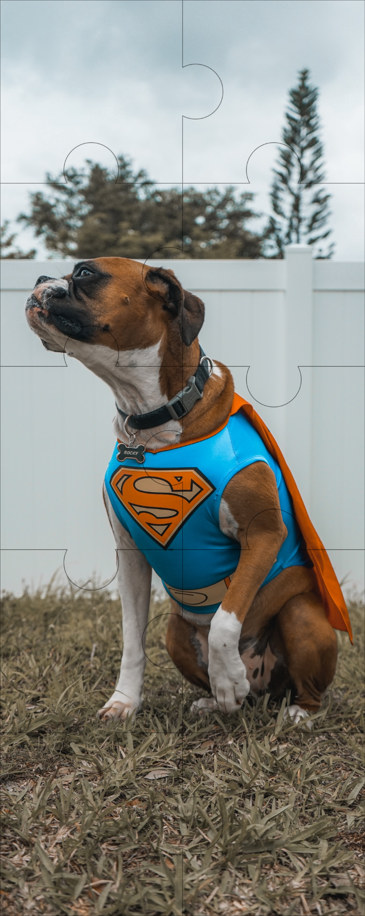
Notes:
Tell the group “You have completed the puzzle!”
Ask, “What does the ‘S’ stand for on the dog’s shirt?” (SuperDog!)
Tell the group: “I feel that by coming to this sibling group and sharing your experiences with others, you did something important. And that makes you a SuperSib!”
Ask: “Does anyone here feel like a SuperSib? Why or why not?”

Slide 16
Coping Skills: What Works for You?
Take deep breaths (breathe from your belly, not your chest)
Move your body (take a walk, stretch, exercise)
Read a good book
Watch a funny movie
Snuggle or play with a pet
Hug a stuffed animal or pillow
Take a bath or hot shower
Rip paper into small pieces
Write a letter to someone that you may never send
Journal (write about what you are struggling with)
Count to 10 slowly
Get a drink of water
Call an adult or friend
Draw or color
Listen to or play music
Walk away
Notes:
Tell the group, “We talked about coping skills in today’s group.”
Ask siblings to share the coping strategies that work for them.
Next, tell the group, “Now we want to share a list of coping skills that other siblings have told us about.”
The coping skills will appear one at a time when you hit the space bar.
Ask the group:
What coping skills have you tried that work for you?
What coping skills would you like to try after today’s group?
Are there any coping skills you use that aren’t on this list?
Go to next slide to wrap up the group.

Slide 17
Wrapping Up
What was your favorite part of today’s group?
What would you change to make the group better?
Notes:
Ask the siblings the questions on the slide. Allow them to respond verbally or in the chat feature. Record the responses.
Let the siblings know when the group will meet again and that they are always welcome to return.
Finally, remind siblings to complete the survey that we are sending to their parent/guardian’s email.
Tell them, “Your responses are important to us and help us improve the group!”
Thank the siblings for participating.

