Slide 1
Meet the Martians
by the Sibling Support Program
Created by Emily Rubin, LICSW © 2025. Do not modify without permission.
Notes:
Introductions: Ask sibs to share their name, age, preferred pronouns, and favorite animal.
Ask the group: “Does everyone know why they are in this group?” and ask siblings to explain.
(“Everyone is here today because they have a sibling with challenges. We know it can be hard to grow up with a sibling that has mental health or behavioral problems.”)
Tell siblings that right now, their parents/guardians are in a separate Zoom group to learn about how to support siblings.
Go to next slide.

Slide 2
Group Rules
This is a safe place.
We respect each other.
Please keep your camera on so we can see each other.
It’s OK to use the chat function but please do so appropriately.
What is said in this group stays in this group.*
Notes:
Ask siblings to take turns reading the rules.
Ask, “What do you think it means that this is a safe place?”
(Be respectful and nonjudgmental, we support each other, etc.)
Tell the siblings they can participate as much as they like and they can always say “pass.”
Ask, “What does it mean that ‘what is said in this group stays in this group’?”
* The only exception is safety-related. We want to make sure that everyone is safe at home and sometimes a family member might need some extra help.

Slide 3
Getting to Know Each Other in 5 Minutes…
If you had a million dollars, how would you spend it?
Notes:
Tell the siblings, “Before we start today’s activity, let’s get to know each other a little bit.”
Ask for a volunteer to read the question that appears after you click the Return button.
Note to facilitators:
You need to click Return for the question to appear.
Try to only spend 5 minutes on this slide so there is time for the group activity.

Slide 4



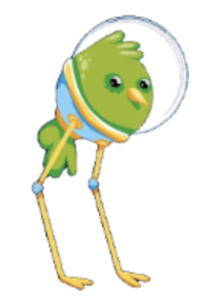

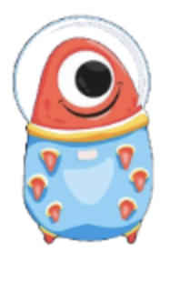

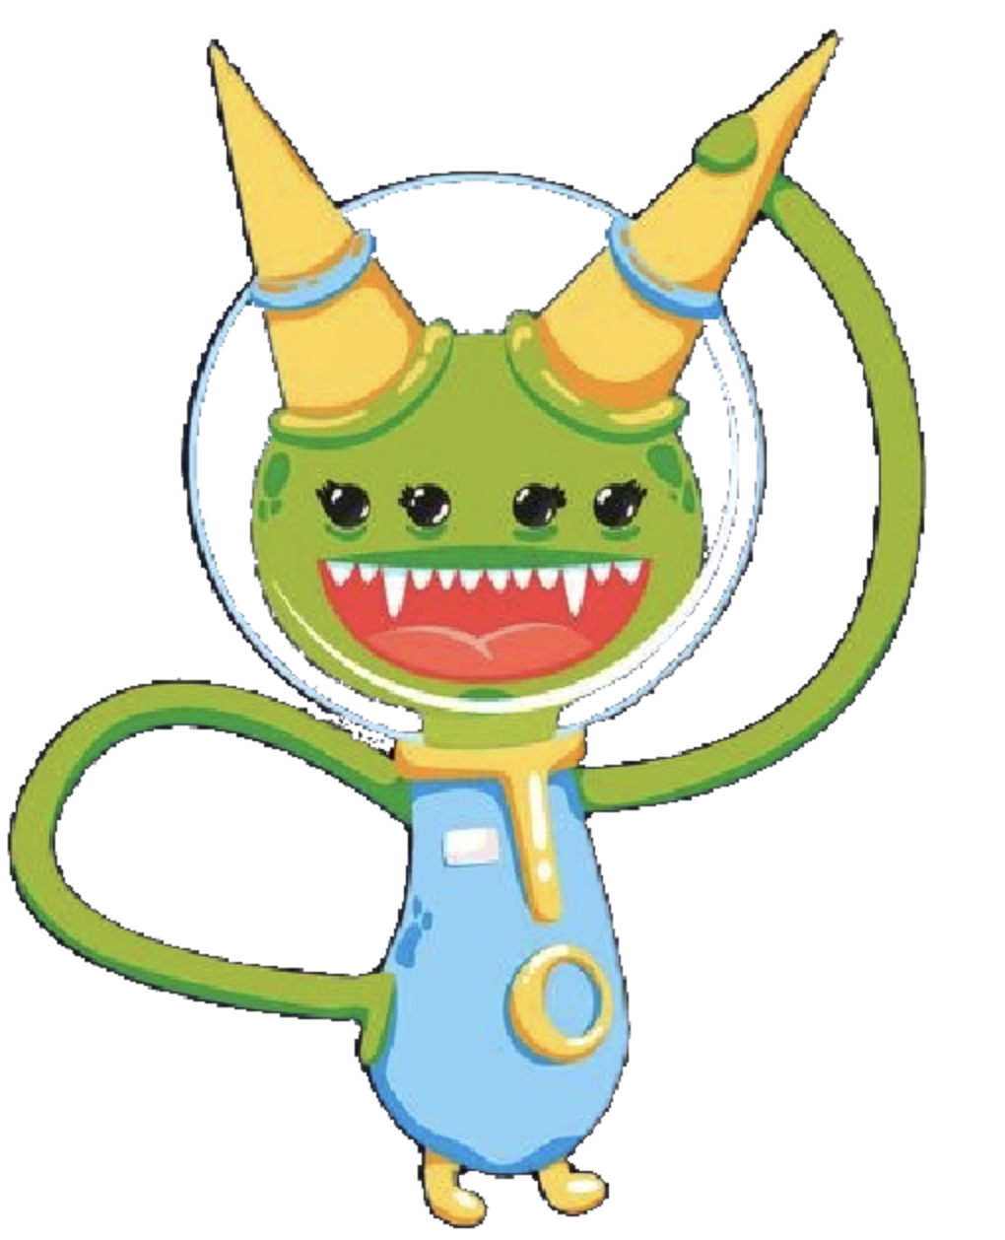
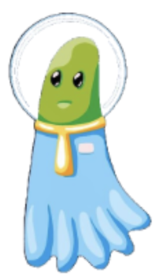
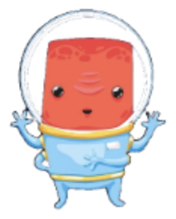
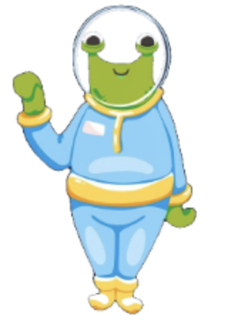
Choose an Alien
1
2
3
4
5
6
7
8
9
10
Wrap-Up
Notes:
Tell the siblings: “Each alien in the Martian family has a question to ask. Your job is to take turns choosing an alien, and then we will discuss the question that appears.”
Tell the siblings, “We will also be talking about coping skills today. Before we get started, would someone define the term ‘coping skills’?” (Things we can do to manage difficult situations.)
Notes to facilitators:
When the activity is over (when all prompts have been selected or before time runs out), click “Wrap-Up” to be brought to the slide on coping skills.
Reminder to take opportunities to validate sibling experiences and identify coping skills throughout the activity.

Slide 5

What’s your favorite memory with your sibling?
OR
What’s your worst memory with your sibling?
Notes:
Love/Hate Relationship Question
Ask a sibling to read the question out loud. Ask if any sibs would like to share. Encourage the sibs to talk to each other when possible.
If needed, prompts for discussion:
Do you have more good memories or bad memories with your sibling? Please explain.
How do you feel when you remember something bad that happened with your sibling? How do you cope with those feelings?
Are you able to forgive your sibling after they hurt your feelings? Why or why not?
Do you ever hurt your sibling’s feelings on purpose? Please explain.
Reminder to take opportunities to validate sibling experiences and identify coping skills.
Click on the home icon to return to the game slide.

Slide 6
My family talks a lot about helping out, but not all my siblings have to do chores. Is this fair?
Notes:
Fair is Not Equal Question
Ask a sibling to read the question out loud. Ask if any sibs would like to share. Encourage the sibs to talk to each other when possible.
If needed, prompts for discussion:
How do you deal with feeling like something is unfair at home? Please explain.
What happens when you talk to your parents/guardians about something that doesn’t feel fair?
Do you have more responsibilities than your sibling does? If so, why might that be?
Do you think your sibling’s life is easier or harder than your life? Please explain.
Reminder to take opportunities to validate sibling experiences and identify coping skills.
Click on the home icon to return to the game slide.

Slide 7
What happens when your sibling is frustrated?
Notes:
Sibling Aggression Question
Ask a sibling to read the question out loud. Ask if any sibs would like to share. Encourage the sibs to talk to each other when possible.
If needed, prompts for discussion:
Do you get scared that your sibling might hurt you or themselves when they get upset? If so, how do you cope with that?
Do you think your sibling has a harder time dealing with their anger or frustration because they have a disability? Please explain.
Do you have a hard time understanding why your sibling behaves the way they do? Does anything help you understand it better?
Reminder to take opportunities to validate sibling experiences and identify coping skills.
Click on the home icon to return to the game slide.

Slide 8
Some kids go to their bedroom when their family starts arguing. Where do you go?
Notes:
Safety Question
Ask a sibling to read the question out loud. Ask if any sibs would like to share. Encourage the sibs to talk to each other when possible.
If needed, prompts for discussion:
Where do you feel safest at home?
Is it a good or bad idea for kids to have locks on their bedroom doors? Please explain.
When you are upset, do you prefer to be alone or talk to an adult? Please explain.
Has anyone shared a room with their sibling? If so, where do you go when you want privacy?
Reminder to take opportunities to validate sibling experiences and identify coping skills.
Click on the home icon to return to the game slide.

Slide 9
My sibling has behavioral problems and my parents let them get away with anything they want to do. This is so unfair! I always follow the rules. Any advice?
Notes:
Family Rules Question
Ask a sibling to read the question out loud. Ask if any sibs would like to share. Encourage the sibs to talk to each other when possible.
If needed, prompts for discussion:
Why do you think parents/guardians might be less strict with a child with behavioral problems?
How does it feel when your parents/guardians treat you differently from your sibling? How do you cope with those feelings?
What are the most important rules a family should have?
Do you think rules should be posted on a wall at home, or should everyone in the family have to remember the rules? Please explain.
Reminder to take opportunities to validate sibling experiences and identify coping skills.
Click on the home icon to return to the game slide..

Slide 10
What would make your life better?
Notes:
Building Self-Esteem Question
Ask a sibling to read the question out loud. Ask if any sibs would like to share. Encourage the sibs to talk to each other when possible.
If needed, prompts for discussion:
If you could change one thing about your life, what would it be? Please explain.
What does it mean when someone says, “The grass is always greener on the other side”? Do you agree or disagree?
What do you do to feel better when you are upset?
Reminder to take opportunities to validate sibling experiences and identify coping skills.
Click on the home icon to return to the game slide.

Slide 11
When was the last time you got angry at a family member?
Notes:
Shame/Embarrassment Question
Ask a sibling to read the question out loud. Ask if any sibs would like to share. Encourage the sibs to talk to each other when possible.
If needed, prompts for discussion:
Have your parents/guardians ever done something that was really embarrassing? Tell us about it.
What helps you feel better when you feel embarrassed?
How often do you feel upset with your sibling? What do they do that makes you upset?
Is it easy or hard for you to forgive other people? Please explain.
Reminder to take opportunities to validate sibling experiences and identify coping skills.
Click on the home icon to return to the game slide.

Slide 12
When was a time you felt guilty? Why did you feel guilty?
Notes:
Sibling Guilt Question
Ask a sibling to read the question out loud. Ask if any sibs would like to share. Encourage the sibs to talk to each other when possible.
If needed, prompts for discussion:
Is it possible for guilt to go away? If so, what helps you feel less guilty?
Do you think your sibling ever feels guilty? Please explain.
Do you feel guilty after you’ve said or done something unkind? If so, what do you do to make it right?
Reminder to take opportunities to validate sibling experiences and identify coping skills.
Click on the home icon to return to the game slide.

Slide 13
I saw my sibling doing something unsafe. They will be mad if I tell my parents, but I am scared. What should I do?
Notes:
Sibling Anxiety Question
Ask a sibling to read the question out loud. Ask if any sibs would like to share. Encourage the sibs to talk to each other when possible.
If needed, prompts for discussion:
Does your sibling ask you to keep secrets from your parents/guardians? How do you handle that?
Do you feel comfortable or uncomfortable around your sibling? Please explain.
Do you have a hard time falling asleep at night, or is it easy for you to fall asleep? Please explain.
Reminder to take opportunities to validate sibling experiences and identify coping skills.
Click on the home icon to return to the game slide.

Slide 14
Do you have good dreams or scary dreams?
Do you believe that dreams have meaning?
Notes:
Mindfulness Question
Ask a sibling to read the question out loud. Ask if any sibs would like to share. Encourage the sibs to talk to each other when possible.
If needed, prompts for discussion:
Do you tend to remember your dreams? How often do you have vivid dreams (dreams that feel very real)?
When you wake up from a scary dream, how do you feel? What do you do to feel better?
Why do you think people have scary dreams?
Why do you think people have good dreams?
Reminder to take opportunities to validate sibling experiences and identify coping skills.
Click on the home icon to return to the game slide.

Slide 15
Coping Skills: What Works for You?
Take deep breaths (breathe from your belly, not your chest)
Move your body (take a walk, stretch, exercise)
Read a good book
Watch a funny movie
Snuggle or play with a pet
Hug a stuffed animal or pillow
Take a bath or hot shower
Rip paper into small pieces
Write a letter to someone that you may never send
Journal (write about what you are struggling with)
Count to 10 slowly
Get a drink of water
Call an adult or friend
Draw or color
Listen to or play music
Walk away
Notes:
Tell the group, “We talked about coping skills in today’s group.”
Ask siblings to share the coping strategies that work for them.
Next, tell the group, “Now we want to share a list of coping skills that other siblings have told us about.”
The coping skills will appear one at a time when you hit the space bar.
Ask the group:
What coping skills have you tried that work for you?
What coping skills would you like to try after today’s group?
Are there any coping skills you use that aren’t on this list?
Go to next slide to wrap up the group.

Slide 16
Wrapping Up
What was your favorite part of today’s group?
What would you change to make the group better?
Notes:
Ask the siblings the questions on the slide. Allow them to respond verbally or in the chat feature. Record the responses.
Let the siblings know when the group will meet again and that they are always welcome to return.
Finally, remind siblings to complete the survey that we are sending to their parent/guardian’s email.
Tell them, “Your responses are important to us and help us improve the group!”
Thank the siblings for participating.

