Slide 1
Love Can Be Hard
by the Sibling Support Program
Created by Emily Rubin, LICSW © 2025. Do not modify without permission.
Notes:
Introductions: Ask sibs to share their name, age, preferred pronouns, and favorite dessert.
Ask the group: “Does everyone know why they are in this group?” and ask siblings to explain.
(“Everyone is here today because they have a sibling with challenges. We know it can be hard to grow up with a sibling that has mental health or behavioral problems.”)
Tell siblings that right now, their parents/guardians are in a separate Zoom group to learn about how to support siblings.
Go to next slide.

Slide 2
Group Rules
This is a safe place.
We respect each other.
Please keep your camera on so we can see each other.
It’s OK to use the chat function but please do so appropriately.
What is said in this group stays in this group.*
Notes:
Ask siblings to take turns reading the rules.
Ask, “What do you think it means that this is a safe place?”
(Be respectful and nonjudgmental, we support each other, etc.)
Tell the siblings they can participate as much as they like and they can always say “pass.”
Ask, “What does it mean that ‘what is said in this group stays in this group’?”
* The only exception is safety-related. We want to make sure that everyone is safe at home and sometimes a family member might need some extra help.

Slide 3
Getting to Know Each Other in 5 Minutes…
Would you rather live in the ocean or on the moon?
Notes:
Tell the siblings, “Before we start today’s activity, let’s get to know each other a little bit.”
Ask for a volunteer to read the question that appears after you click the Return button.
Note to facilitators:
You need to click Return for the question to appear.
Try to only spend 5 minutes on this slide so there is time for the group activity.

Slide 4

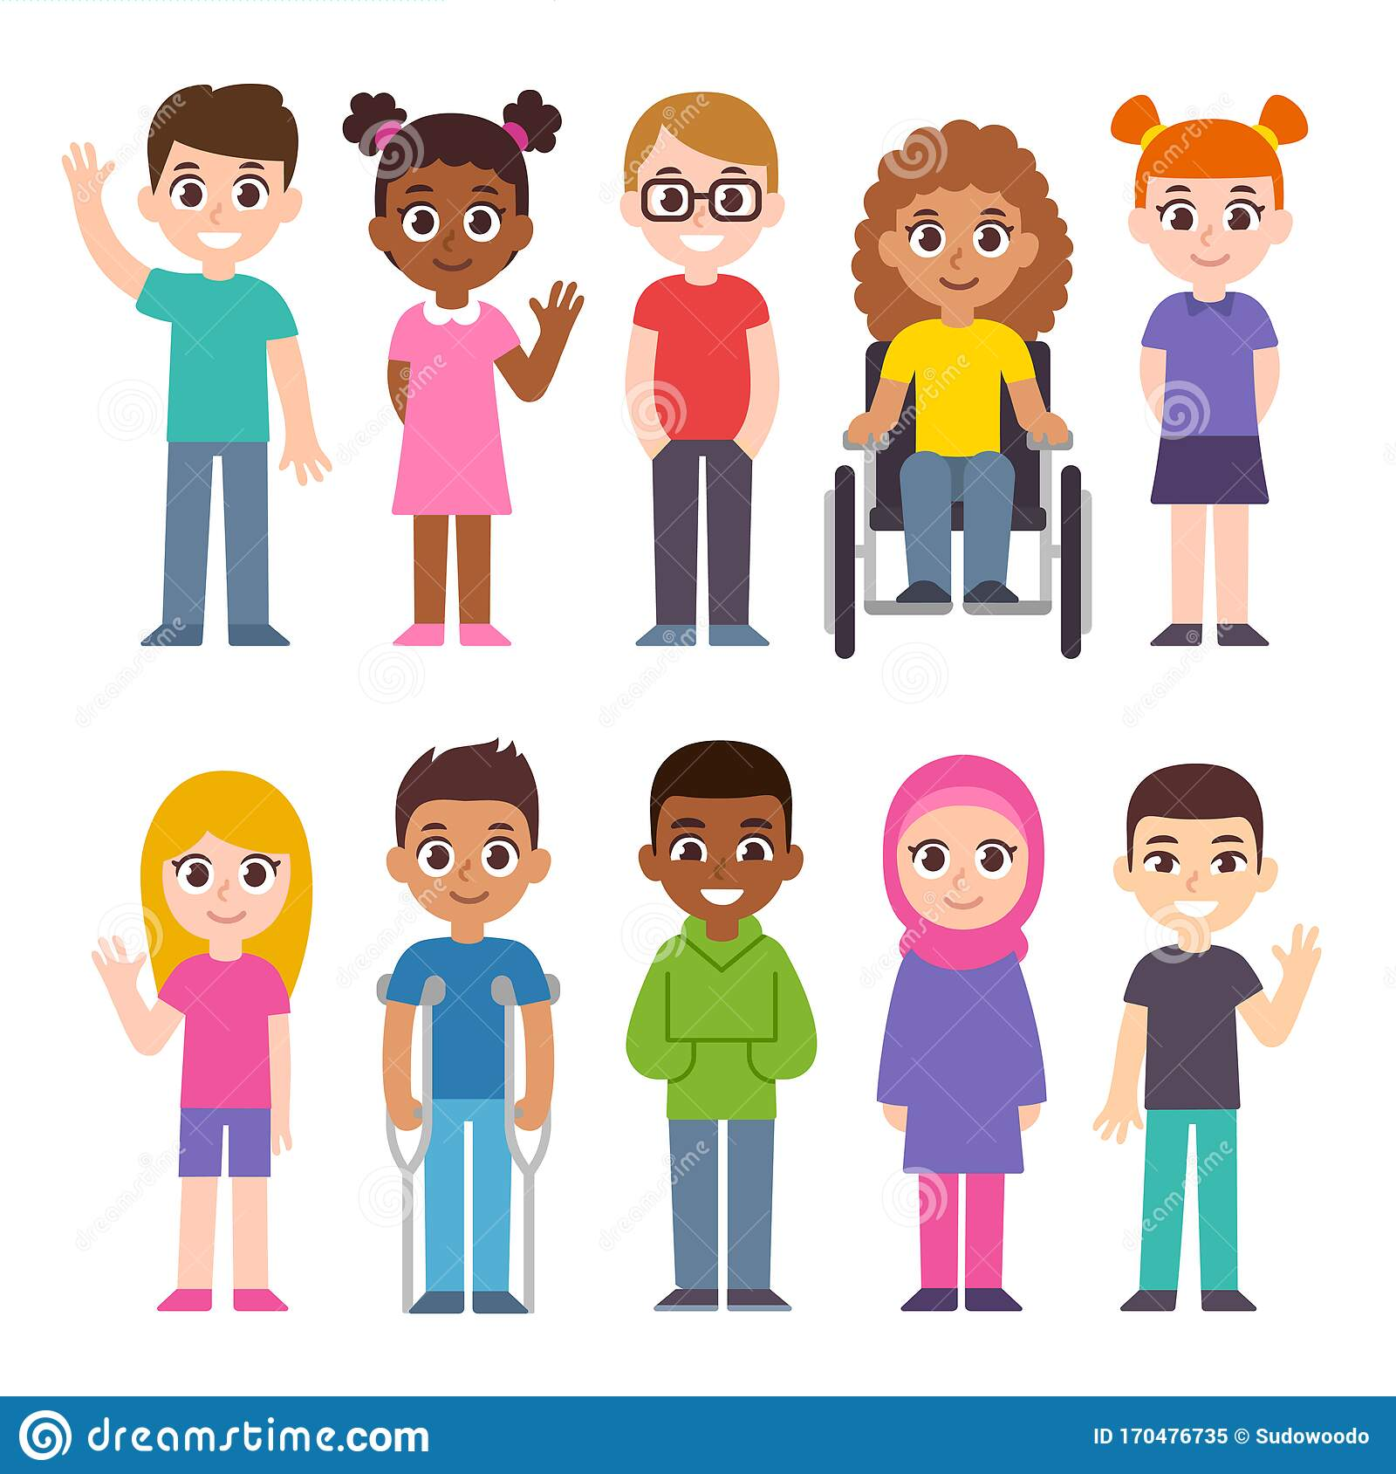
Choose a Friend
1
2
3
4
5
6
7
8
9
10
Wrap-Up
Notes:
Tell the siblings, “Today we are going to do an activity where siblings take turns choosing a friend on the slide, and then we will discuss the question that appears.”
Tell the siblings, “We will also be talking about coping skills today. Before we get started, would someone define the term ‘coping skills’?” (Things we can do to manage difficult situations.)
Notes to facilitators:
When the activity is over (when all prompts have been selected or before time runs out), click “Wrap-Up” to be brought to the slide on coping skills.
Reminder to take opportunities to validate sibling experiences and identify coping skills throughout the activity.

Slide 5

What makes you happy about your sibling?
OR
What makes you mad about your sibling?
Notes:
Love/Hate Relationship Question
Ask a sibling to read the question out loud. Ask if any sibs would like to share. Encourage the sibs to talk to each other when possible.
If needed, prompts for discussion:
How often does your sibling make you mad or upset? How do you deal with it when that happens?
Do you enjoy spending time with your sibling? If so, what do you like to do with them?
Is there anything you love about your sibling? Please explain.
Is there anything you hate about your sibling? Please explain.
Reminder to take opportunities to validate sibling experiences and identify coping skills.
Click on the Home icon to go back to the game slide.

Slide 6
I don’t want to invite friends over because of my sibling’s behavior. Do other kids feel this way? Any advice?
Notes:
Fair is Not Equal Question
Ask a sibling to read the question out loud. Ask if any sibs would like to share. Encourage the sibs to talk to each other when possible.
If needed, prompts for discussion:
Do you ever have friends over to your house? Why or why not?
Have you ever asked your parents if you could have your friends over and they said no? How did that make you feel, and how did you cope with those feelings?
Does your sibling have a hard time in social situations? If so, why do you think this might be?
Reminder to take opportunities to validate sibling experiences and identify coping skills.
Click on the home icon to return to the game slide.

Slide 7
Why are some kids more aggressive than others?
Notes:
Sibling Aggression Question
Ask a sibling to read the question out loud. Ask if any sibs would like to share. Encourage the sibs to talk to each other when possible.
If needed, prompts for discussion:
Does your sibling tend to be aggressive? Tell us about it.
What happens when your sibling gets upset? Are they more aggressive? Please explain.
Do you ever worry that your sibling might hurt you (either by accident or on purpose)? How do you cope with that fear?
Do you have anyone to talk to when you don’t feel safe around your sibling? If so, what kind of advice do they give to you?
Does anyone have a sibling who is aggressive to themself, such as hurting themself? Please explain.
Reminder to take opportunities to validate sibling experiences and identify coping skills.
Click on the home icon to return to the game slide.

Slide 8
What do you do to feel better when you’re scared?
Notes:
Safety Question
Ask a sibling to read the question out loud. Ask if any sibs would like to share. Encourage the sibs to talk to each other when possible.
If needed, prompts for discussion:
Does home feel like a safe place? Why or why not?
Do you ever feel scared of your sibling? Please explain.
What makes you feel safe?
What kinds of things are you afraid of? How do you stay calm when you run into something you’re afraid of?
Reminder to take opportunities to validate sibling experiences and identify coping skills.
Click on the home icon to return to the game slide.

Slide 9
My cousin doesn’t have any rules in her family, and my family has too many rules. Which way is better?
Notes:
Family Rules Question
Ask a sibling to read the question out loud. Ask if any sibs would like to share. Encourage the sibs to talk to each other when possible.
If needed, prompts for discussion:
Do you have a lot of rules to follow at home? Name a few of them.
Does your sibling follow the same rules as you, or do they have different rules? Please explain.
Are your parents more strict or less strict with your sibling? How does that make you feel?
Why do we need rules? What would happen if we didn’t have any?
Reminder to take opportunities to validate sibling experiences and identify coping skills.
Click on the home icon to return to the game slide.

Slide 10
Do you have a special talent or skill? Tell us what you're good at.
Notes:
Building Self-Esteem Question
Ask a sibling to read the question out loud. Ask if any sibs would like to share. Encourage the sibs to talk to each other when possible.
If needed, prompts for discussion:
What do you enjoy doing in your free time?
How do you think your sibling feels about your talents and skills?
Do you have a skill you’d like to improve? How do you plan on doing that?
Have you ever heard someone say, “Nobody’s perfect” or “Practice makes perfect”? What are your thoughts on that?
Reminder to take opportunities to validate sibling experiences and identify coping skills.
Click on the home icon to return to the game slide.

Slide 11
Has your sibling ever acted out in a public place? If so,
how did it feel?
Notes:
Shame/Embarrassment Question
Ask a sibling to read the question out loud. Ask if any sibs would like to share. Encourage the sibs to talk to each other when possible.
If needed, prompts for discussion:
What do you do when you feel embarrassed by your sibling?
Can you love someone and still feel embarrassed by them? Explain your answer.
Does everyone feel embarrassed by their family at some point in their life? Please explain.
Reminder to take opportunities to validate sibling experiences and identify coping skills.
Click on the Home icon to go back to the game slide.

Slide 12
Do all siblings feel guilty sometimes?
Notes:
Sibling Guilt Question
Ask a sibling to read the question out loud. Ask if any sibs would like to share. Encourage the sibs to talk to each other when possible.
If needed, prompts for discussion:
Describe a time you felt guilty. What happened?
Is feeling guilty ever a good thing? Please explain.
Let’s say you are tired and accidentally snap at your sibling, causing them to cry. Would you feel guilty?
What are some ways to help guilty feelings go away? (ex: tell the truth, apologize to someone if you did something wrong, etc.)
Does your sibling apologize to you if they hurt your feelings? Do you think their disability makes it harder for them to recognize when they did something hurtful?
Reminder to take opportunities to validate sibling experiences and identify coping skills.
Click on the home icon to return to the game slide.

Slide 13
What do you wish your sibling knew about how you felt?
Notes:
Sibling Anxiety Question
Ask a sibling to read the question out loud. Ask if any sibs would like to share. Encourage the sibs to talk to each other when possible.
If needed, prompts for discussion:
What is it like to have a sibling that struggles with their behavior?
In what ways is your life at home different from other kids your age?
Are there times you wish your life was easier? What would make your life easier?
Reminder to take opportunities to validate sibling experiences and identify coping skills.
Click on the home icon to return to the game slide.

Slide 14
Tell us about a time you used exercise, dance, sports, or other movement to feel better.
Notes:
Mindfulness Question
Ask a sibling to read the question out loud. Ask if any sibs would like to share. Encourage the sibs to talk to each other when possible.
If needed, prompts for discussion:
Do you like to do physical activity? Tell us about it.
Does exercising help you feel better when you are upset? Why or why not?
Do you have gym class at school? If so, do you like it or dislike it?
Being inclusive means making sure everyone, whether or not they have a disability, can participate in the same activities. Do you think inclusion is a good idea or a bad idea? Please explain.
Reminder to take opportunities to validate sibling experiences and identify coping skills.
Click on the home icon to return to the game slide.

Slide 15
Coping Skills: What Works for You?
Take deep breaths (breathe from your belly, not your chest)
Move your body (take a walk, stretch, exercise)
Read a good book
Watch a funny movie
Snuggle or play with a pet
Hug a stuffed animal or pillow
Take a bath or hot shower
Rip paper into small pieces
Write a letter to someone that you may never send
Journal (write about what you are struggling with)
Count to 10 slowly
Get a drink of water
Call an adult or friend
Draw or color
Listen to or play music
Walk away
Notes:
Tell the group, “We talked about coping skills in today’s group.”
Ask siblings to share the coping strategies that work for them.
Next, tell the group, “Now we want to share a list of coping skills that other siblings have told us about.”
The coping skills will appear one at a time when you hit the space bar.
Ask the group:
What coping skills have you tried that work for you?
What coping skills would you like to try after today’s group?
Are there any coping skills you use that aren’t on this list?
Go to next slide to wrap up the group.

Slide 16
Wrapping Up
What was your favorite part of today’s group?
What would you change to make the group better?
Notes:
Ask the siblings the questions on the slide. Allow them to respond verbally or in the chat feature. Record the responses.
Let the siblings know when the group will meet again and that they are always welcome to return.
Finally, remind siblings to complete the survey that we are sending to their parent/guardian’s email.
Tell them, “Your responses are important to us and help us improve the group!”
Thank the siblings for participating.

