Slide 1
What is Fair?
by the Sibling Support Program
Created by Emily Rubin, LICSW © 2025. Do not modify without permission.
Notes:
Introductions: Ask sibs to share their name, age, preferred pronouns, and favorite color.
Ask the group: “Does everyone know why they are in this group?” and ask siblings to explain.
(“Everyone is here today because they have a sibling with challenges. We know it can be hard to grow up with a sibling that has mental health or behavioral problems.”)
Tell siblings that right now, their parents/guardians are in a separate Zoom group to learn about how to support siblings.
Go to next slide.

Slide 2
Group Rules
This is a safe place.
We respect each other.
Please keep your camera on so we can see each other.
It’s OK to use the chat function but please do so appropriately.
What is said in this group stays in this group.*
Notes:
Ask siblings to take turns reading the rules.
Ask, “What do you think it means that this is a safe place?”
(Be respectful and nonjudgmental, we support each other, etc.)
Tell the siblings they can participate as much as they like and they can always say “pass.”
Ask, “What does it mean that ‘what is said in this group stays in this group’?”
* The only exception is safety-related. We want to make sure that everyone is safe at home and sometimes a family member might need some extra help.

Slide 3
Getting to Know Each Other in 5 Minutes…
Would you rather travel back in time or forward in time? Why?
Notes:
Tell the siblings, “Before we start today’s activity, let’s get to know each other a little bit.”
Ask for a volunteer to read the question that appears after you click the Return button.
Note to facilitators:
You need to click Return for the question to appear.
Try to only spend 5 minutes on this slide so there is time for the group activity.

Slide 4

Choose a Handshake
1
2
3
4
5
6
7
8
9
Wrap-Up
Notes:
Tell the siblings, “Today we are going to do an activity where siblings take turns choosing a number, and then we discuss the question that appears.”
Tell the siblings, “We will also be talking about coping skills today. Before we get started, would someone define the term ‘coping skills’?” (Things we can do to manage difficult situations.)
Note to facilitators:
When the activity is over (when all prompts have been selected or before time runs out), click “Wrap-Up” to be brought to the slide on coping skills.
Reminder to take opportunities to validate sibling experiences and identify coping skills throughout the activity.

Slide 5

Is it fair if kids in the same family have different bedtimes? Why or why not?
Notes:
Family Rules Question
Ask a sibling to read the question out loud. Ask if any sibs would like to share. Encourage the sibs to talk to each other when possible.
If needed, prompts for discussion:
Are there different bedtimes in your family? Please explain.
What are some reasons kids in the same family might have different bedtimes?
Do you think kids should have bedtimes at all?
What happens if kids don’t get enough sleep? (fatigue, behavior problems, inability to focus)
Reminder to take opportunities to validate sibling experiences and identify coping skills.
Click on the home icon to return to the game slide.

Slide 6
My sibling doesn’t eat meat and the school cafeteria doesn’t always have a vegetarian option. We don’t have time to make lunch at home. What do you suggest?
Notes:
Building Self-Esteem Question
Ask a sibling to read the question out loud. Ask if any sibs would like to share. Encourage the sibs to talk to each other when possible.
If needed, prompts for discussion:
Should school cafeterias provide options for everyone who has food allergies or food dislikes?
What if the sibling in this situation has a disability that makes it hard to be flexible?
Is anyone here vegetarian? How would you deal with this situation?
Why do people become a vegetarian?
Is this school policy intended to punish people who are vegetarian? Please explain.
Reminder to take opportunities to validate sibling experiences and identify coping skills.
Click on the home icon to return to the game slide.

Slide 7
Is it fair if your parents/guardians lock up scissors and knives because they are worried your sibling might use them to hurt themself? Why or why not?
Notes:
Safety Question
Ask a sibling to read the question out loud. Ask if any sibs would like to share. Encourage the sibs to talk to each other when possible.
If needed, prompts for discussion:
Have you experienced something similar? Tell us about it.
Why would a person hurt themself on purpose?* (to relieve inner pain, to get attention, to experiment)
What would be “fair” in this situation?
What do most people use scissors and knives for?
* Discussion prompt 2 can be difficult for young siblings to comprehend. Keep it simple.
Reminder to take opportunities to validate sibling experiences and identify coping skills.
Click on the home icon to return to the game slide.

Slide 8
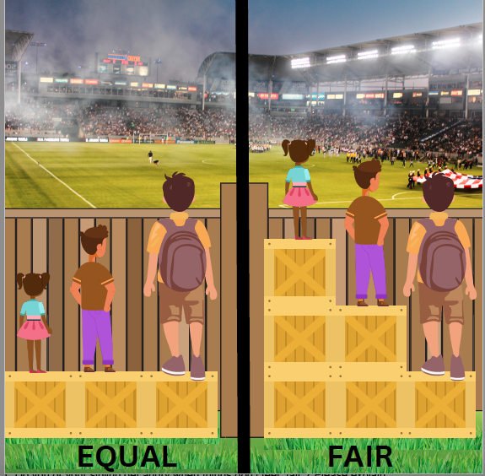
What does this picture mean?
Notes:
Sibling Aggression Question
Ask a sibling to read the question out loud. Ask if any sibs would like to share. Encourage the sibs to talk to each other when possible.
If needed, prompts for discussion:
Do you or your sibling get angry when things don’t feel “fair”? Please explain.
When is it OK for kids to get extra support to make a situation more fair?
Have you or anyone you know needed accommodations at school or at home? Tell us about it.
What makes one picture fair and one picture equal?*
What is the difference between fair and equal?*
* This can be a difficult question for young siblings because they may not have developed abstract reasoning skills. Keep it simple.
Reminder to take opportunities to validate sibling experiences and identify coping skills.
Click on the home icon to return to the game slide.

Slide 9
Share something unfair that recently happened to you.
How did you deal with it?
Notes:
Fair is Not Equal Question
Ask a sibling to read the question out loud. Ask if any sibs would like to share. Encourage the sibs to talk to each other when possible.
If needed, prompts for discussion:
How did the unfair situation make you feel?
What, if anything, did you learn from the unfair situation?
What coping skills did you use?
What would you do differently if the situation happened again?
Reminder to take opportunities to validate sibling experiences and identify coping skills.
Click on the home icon to return to the game slide.

Slide 10
What do you wish your parents/guardians would do differently?
Notes:
Sibling Guilt Question
Ask a sibling to read the question out loud. Ask if any sibs would like to share. Encourage the sibs to talk to each other when possible.
If needed, prompts for discussion:
Do you feel like your parents/guardians understand you? Why or why not?
Do you ever feel guilty about things happening at home? Please explain.
Do your parents/guardians ever behave in confusing ways? Why do you think this happens?
Does one parent/guardian say one thing, and the other parent/guardian say another thing? Please explain.
What would you do differently if you were the parent/guardian?
Reminder to take opportunities to validate sibling experiences and identify coping skills.
Click on the home icon to return to the game slide.

Slide 11
If you were a parent and one of your children had a disability, what would you do to make sure all your children felt they were being treated fairly?
Notes:
Mindfulness Question
Ask a sibling to read the question out loud. Ask if any sibs would like to share. Encourage the sibs to talk to each other when possible.
If needed, prompts for discussion:
Would the type of disability make a difference? Please explain.
Does the attitude of parents/guardians make a difference? Please explain.
How does it feel to have a challenging sibling?
Do other people understand what it’s like to have a challenging sibling?
Reminder to take opportunities to validate sibling experiences and identify coping skills.
Click on the home icon to return to the game slide.

Slide 12
My sibling gets all my parents’ attention. It makes me feel like my parents care more about my sibling than they care about me.
Does anyone else feel this way?
Notes:
Shame/Embarrassment Question
Ask a sibling to read the question out loud. Ask if any sibs would like to share. Encourage the sibs to talk to each other when possible.
If needed, prompts for discussion:
How do you feel when your sibling gets more attention than you? How do you handle it?
Have you ever felt embarrassed by the amount of attention your sibling gets? Please explain.
What are the reasons why some children might get more attention?
What do you do to get attention from your parents/guardians?
What is the difference between getting positive attention and negative attention?
Reminder to take opportunities to validate sibling experiences and identify coping skills.
Click on the home icon to return to the game slide.

Slide 13
Sometimes I love my sibling and other times I hate my sibling. Do other people feel that way?
Notes:
Love/Hate Question
Ask a sibling to read the question out loud. Ask if any sibs would like to share. Encourage the sibs to talk to each other when possible.
If needed, prompts for discussion:
What is a love/hate relationship? (When you are best friends one minute and worst enemies the next.)
Does your sibling do things that make you hate them? Give an example. Why do you think they do that?
Is it possible for siblings to outgrow a love/hate relationship with each other? Please explain.
Do you think you will be friendly with your sibling when you are adults? Why or why not?
Reminder to take opportunities to validate sibling experiences and identify coping skills.
Click on the home icon to return to the game slide.

Slide 14
Coping Skills: What Works for You?
Take deep breaths (breathe from your belly, not your chest)
Move your body (take a walk, stretch, exercise)
Read a good book
Watch a funny movie
Snuggle or play with a pet
Hug a stuffed animal or pillow
Take a bath or hot shower
Rip paper into small pieces
Write a letter to someone that you may never send
Journal (write about what you are struggling with)
Count to 10 slowly
Get a drink of water
Call an adult or friend
Draw or color
Listen to or play music
Walk away
Notes:
Tell the group, “We talked about coping skills in today’s group.”
Ask siblings to share the coping strategies that work for them.
Next, tell the group, “Now we want to share a list of coping skills that other siblings have told us about.”
The coping skills will appear one at a time when you hit the space bar.
Ask the group:
What coping skills have you tried that work for you?
What coping skills would you like to try after today’s group?
Are there any coping skills you use that aren’t on this list?
Go to next slide to wrap up the group.

Slide 15
Wrapping Up
What was your favorite part of today’s group?
What would you change to make the group better?
Notes:
Ask the siblings the questions on the slide. Allow them to respond verbally or in the chat feature. Record the responses.
Let the siblings know when the group will meet again and that they are always welcome to return.
Finally, remind siblings to complete the survey that we are sending to their parent/guardian’s email.
Tell them, “Your responses are important to us and help us improve the group!”
Thank the siblings for participating.

