Slide 1
Strong Siblings
by the Sibling Support Program
Created by Emily Rubin, LICSW © 2025. Do not modify without permission.
Notes:
Introductions: Ask sibs to share their name, age, preferred pronouns, and favorite animal.
Ask the group: “Does everyone know why they are in this group?” and ask siblings to explain.
(“Everyone is here today because they have a sibling with challenges. We know it can be hard to grow up with a sibling that has mental health or behavioral problems.”)
Tell siblings that right now, their parents/guardians are in a separate Zoom group to learn about how to support siblings.
Go to next slide.

Slide 2
Group Rules
This is a safe place.
We respect each other.
Please keep your camera on so we can see each other.
It’s OK to use the chat function but please do so appropriately.
What is said in this group stays in this group.*
Notes:
Ask siblings to take turns reading the rules.
Ask, “What do you think it means that this is a safe place?”
(Be respectful and nonjudgmental, we support each other, etc.)
Tell the siblings they can participate as much as they like and they can always say “pass.”
Ask, “What does it mean that ‘what is said in this group stays in this group’?”
* The only exception is safety-related. We want to make sure that everyone is safe at home and sometimes a family member might need some extra help.

Slide 3
Getting to Know Each Other in 5 Minutes…
Do you ever want to become famous? Why or why not?
Notes:
Tell the siblings, “Before we start today’s activity, let’s get to know each other a little bit.”
Ask for a volunteer to read the question that appears after you click the Return button.
Note to facilitators:
You need to click Return for the question to appear.
Try to only spend 5 minutes on this slide so there is time for the group activity.

Slide 4
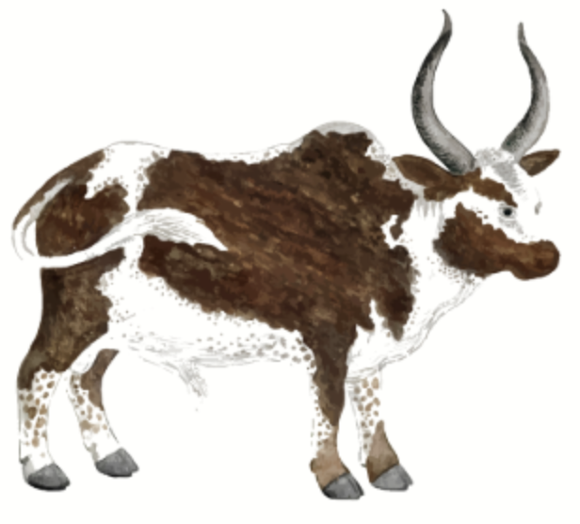
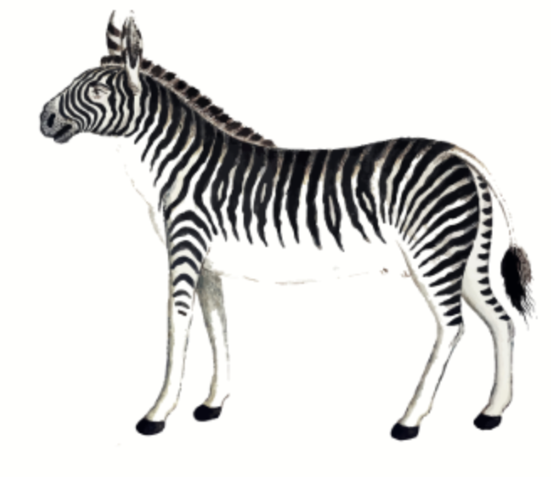
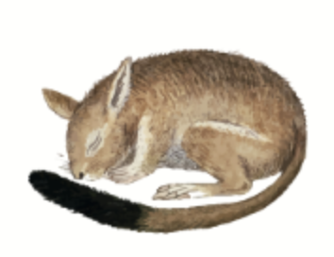
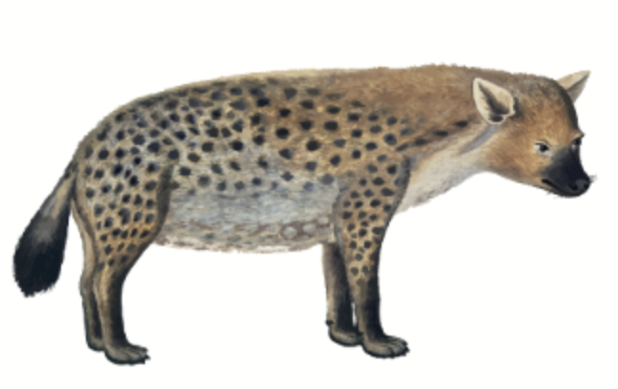
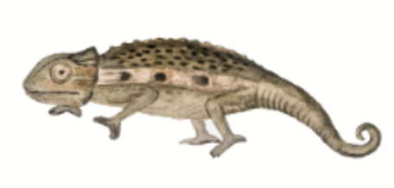
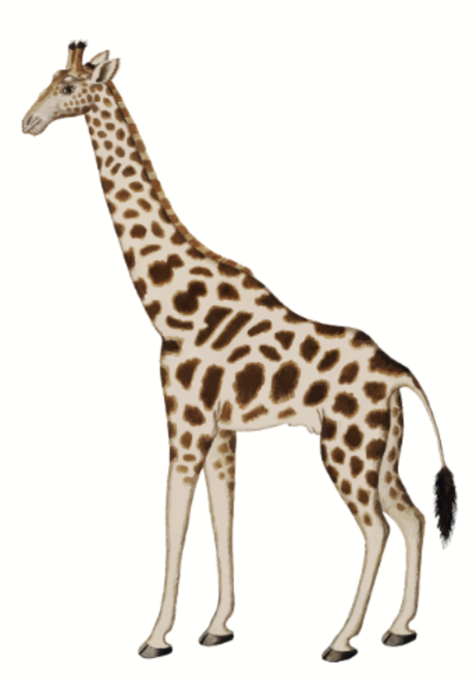
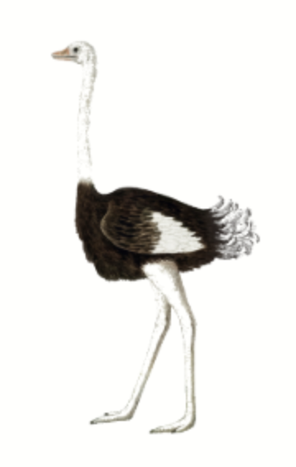
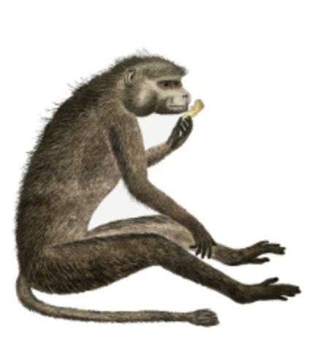

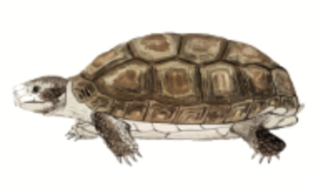
Choose an Animal
1
2
3
4
5
6
7
8
9
10
Wrap-Up
Notes:
Tell the siblings, “Today we are going to do an activity where siblings take turns choosing a strong animal, and then we discuss the question that appears.”
Tell the siblings, “We will also be talking about coping skills today. Before we get started, would someone define the term ‘coping skills’?” (Things we can do to manage difficult situations.)
Notes to facilitators:
When the activity is over (when all prompts have been selected or before time runs out), click “Wrap-Up” to be brought to the slide on coping skills.
Reminder to take opportunities to validate sibling experiences and identify coping skills throughout the activity.

Slide 5

What does it mean to love someone?
Notes:
Love/Hate Relationship Question
Tell the group: “You clicked on an ox!”
Ask a sibling to read the question out loud. Ask if any sibs would like to share. Encourage the sibs to talk to each other when possible.
If needed, prompts for discussion:
Is there anyone you love? Why do you love them?
Do you love your sibling? Why or why not?
Do people have to love their siblings and parents because they are family? Please explain.
Is it possible to love someone but not like them? Please explain.
Reminder to take opportunities to validate sibling experiences and identify coping skills.
Click on the home icon to return to the game slide.

Slide 6
What do you do when your sibling breaks a rule?
Notes:
Fair is Not Equal Question
Tell the group: “You clicked on a kangaroo rat!”
Ask a sibling to read the question out loud. Ask if any sibs would like to share. Encourage the sibs to talk to each other when possible.
If needed, prompts for discussion:
How do you feel when you break a rule? Please explain.
Do you and your siblings follow the same rules? If not, does that feel fair? Please explain.
Is it possible for things to be completely fair all the time? Why or why not?
Reminder to take opportunities to validate sibling experiences and identify coping skills.
Click on the home icon to return to the game slide.

Slide 7
What happens when your sibling gets angry?
Notes:
Sibling Aggression Question
Tell the group: “You clicked on a hyena!”
Ask a sibling to read the question out loud. Ask if any sibs would like to share. Encourage the sibs to talk to each other when possible.
If needed, prompts for discussion:
What kinds of things make your sibling angry? Give some examples.
Has your sibling ever hurt you or themself when they get angry? How do you deal with those situations?
Do you feel scared of your sibling when they are angry? How do you handle that?
Do you ever try to help your sibling calm down? If so, how?
Reminder to take opportunities to validate sibling experiences and identify coping skills.
Click on the home icon to return to the game slide.

Slide 8
If you were president, what would you do to make everyone feel safe?
Notes:
Safety Question
Tell the group: “You clicked on a chameleon!”
Ask a sibling to read the question out loud. Ask if any sibs would like to share. Encourage the sibs to talk to each other when possible.
If needed, prompts for discussion:
Describe a time you didn’t feel safe. What happened? How did you handle it?
Do you feel safe at home? Why or why not?
Do you feel safe around your sibling? Why or why not?
Is there anyone in your life who helps keep you safe? Please explain.
Reminder to take opportunities to validate sibling experiences and identify coping skills.
Click on the home icon to return to the game slide.

Slide 9
My sibling gets bullied on the school bus but won’t tell my parents.
What should I do?
Notes:
Family Rules Question
Tell the group: “You clicked on a giraffe!”
Ask a sibling to read the question out loud. Ask if any sibs would like to share. Encourage the sibs to talk to each other when possible.
If needed, prompts for discussion:
What kinds of rules do you have at home? Are there any that you don’t like? Please explain.
Is it OK to keep secrets from your parents/guardians? Please explain.
Do you feel comfortable telling your parents or another adult when something is going on with your sibling? Why or why not?
Reminder to take opportunities to validate sibling experiences and identify coping skills.
Click on the home icon to return to the game slide.

Slide 10
If you have children in the future, what kind of parent would
you be?
Notes:
Building Self-Esteem Question
Tell the group: “You clicked on a tortoise!”
Ask a sibling to read the question out loud. Ask if any sibs would like to share. Encourage the sibs to talk to each other when possible.
If needed, prompts for discussion:
What kind of qualities do you think a good parent has? Why did you choose those qualities?
Is it more difficult to be a parent if you have a child with a disability? Why or why not?
As a parent, is it better to be your child’s friend or the person who enforces rules? Is it possible to be both?
Reminder to take opportunities to validate sibling experiences and identify coping skills.
Click on the home icon to return to the game slide.

Slide 11
When was the last time you made a mistake? Were you kind to yourself afterwards?
Notes:
Shame/Embarrassment Question
Tell the group: “You clicked on a rhinoceros!”
Ask a sibling to read the question out loud. Ask if any sibs would like to share. Encourage the sibs to talk to each other when possible.
If needed, prompts for discussion:
What does it mean to be kind to yourself? Please explain.
Do you think it’s true that people learn from their mistakes? Please explain.
Have you ever felt embarrassed by mistakes your sibling made? If so, how did you handle that?
How do you feel after you make a mistake? If those feelings are negative, how do you cope with them?
Reminder to take opportunities to validate sibling experiences and identify coping skills.
Click on the home icon to return to the game slide.

Slide 12
Would your life be different if your sibling didn’t have problems?
How?
Notes:
Sibling Guilt Question
Tell the group: “You clicked on a baboon!”
Ask a sibling to read the question out loud. Ask if any sibs would like to share. Encourage the sibs to talk to each other when possible.
If needed, prompts for discussion:
Do you sometimes wish you had a “normal” sibling? Why or why not?
Do you think your parents/guardians would give you more attention if your sibling didn’t have extra challenges?
Is it possible to love someone and still wish something about them was different? Please explain.
Reminder to take opportunities to validate sibling experiences and identify coping skills.
Click on the home icon to return to the game slide.

Slide 13
Does your family understand how you feel?
Notes:
Sibling Anxiety Question
Tell the group: “You clicked on a giraffe!”
Ask a sibling to read the question out loud. Ask if any sibs would like to share. Encourage the sibs to talk to each other when possible.
If needed, prompts for discussion:
Is it hard to talk about how you feel in your family? Why or why not?
When you tell a friend how you are feeling, do you think they understand? Why or why not?
Do you sometimes feel like nobody understands how you feel? If so, how do you deal with that?
Reminder to take opportunities to validate sibling experiences and identify coping skills.
Click on the home icon to return to the game slide.

Slide 14
Who should be allowed to have a therapy animal?
Notes:
Mindfulness Question
Tell the group: “You clicked on an ostrich!”
Ask a sibling to read the question out loud. Ask if any sibs would like to share. Encourage the sibs to talk to each other when possible.
If needed, prompts for discussion:
What is a therapy animal?
Why do people have therapy animals?
What kinds of animals are well suited to be therapy animals?
Have you ever seen a dog in public that has a vest that says, “Service Dog”? Why do you think you’re not allowed to pet those dogs?
Reminder to take opportunities to validate sibling experiences and identify coping skills.
Click on the home icon to return to the game slide.

Slide 15
Coping Skills: What Works for You?
Take deep breaths (breathe from your belly, not your chest)
Move your body (take a walk, stretch, exercise)
Read a good book
Watch a funny movie
Snuggle or play with a pet
Hug a stuffed animal or pillow
Take a bath or hot shower
Rip paper into small pieces
Write a letter to someone that you may never send
Journal (write about what you are struggling with)
Count to 10 slowly
Get a drink of water
Call an adult or friend
Draw or color
Listen to or play music
Walk away
Notes:
Tell the group, “We talked about coping skills in today’s group.”
Ask siblings to share the coping strategies that work for them.
Next, tell the group, “Now we want to share a list of coping skills that other siblings have told us about.”
The coping skills will appear one at a time when you hit the space bar.
Ask the group:
What coping skills have you tried that work for you?
What coping skills would you like to try after today’s group?
Are there any coping skills you use that aren’t on this list?
Go to next slide to wrap up the group.

Slide 16
Wrapping Up
What was your favorite part of today’s group?
What would you change to make the group better?
Notes:
Ask the siblings the questions on the slide. Allow them to respond verbally or in the chat feature. Record the responses.
Let the siblings know when the group will meet again and that they are always welcome to return.
Finally, remind siblings to complete the survey that we are sending to their parent/guardian’s email.
Tell them, “Your responses are important to us and help us improve the group!”
Thank the siblings for participating.

