Slide 1
A Part of Me
by the Sibling Support Program
Created by Emily Rubin, LICSW © 2025. Do not modify without permission.
Notes:
Introductions: Ask siblings to share their name, age, preferred pronouns, and favorite color.
Ask the group: “Does everyone know why they are in this group?” and ask siblings to explain.
(“Everyone is here today because they have a sibling with challenges. We know it can be hard to grow up with a sibling that has mental health or behavioral problems.”)
Tell siblings that right now, their parents/guardians are in a separate Zoom group to learn about how to support siblings.
Go to next slide.

Slide 2
Group Rules
This is a safe place.
We respect each other.
Please keep your camera on so siblings can see each other.
It’s OK to use the chat function but please do so appropriately.
What is said in this group stays in this group.*
Notes:
Ask siblings to take turns reading the rules.
Ask, “What do you think it means that this is a safe place?”
(Be respectful and nonjudgmental, we support each other, etc.)
Tell the siblings they can participate as much as they like and they can always say “pass.”
Ask, “What does it mean that ‘what is said in this group, stays in this group’?”
* The only exception is safety-related. We want to make sure that everyone is safe at home and sometimes a family member might need some extra help.

Slide 3
Getting to Know Each Other in 5 Minutes…
If you could choose anywhere to go on vacation, where would you go?
Notes:
Tell the siblings, “Before we start today’s activity, let’s get to know each other a little bit.”
Ask for a volunteer to read the question that appears after you click the Return button.
Note to facilitators:
You need to click Return for the question to appear.
Try to only spend 5 minutes on this slide so there is time for the group activity.

Slide 4
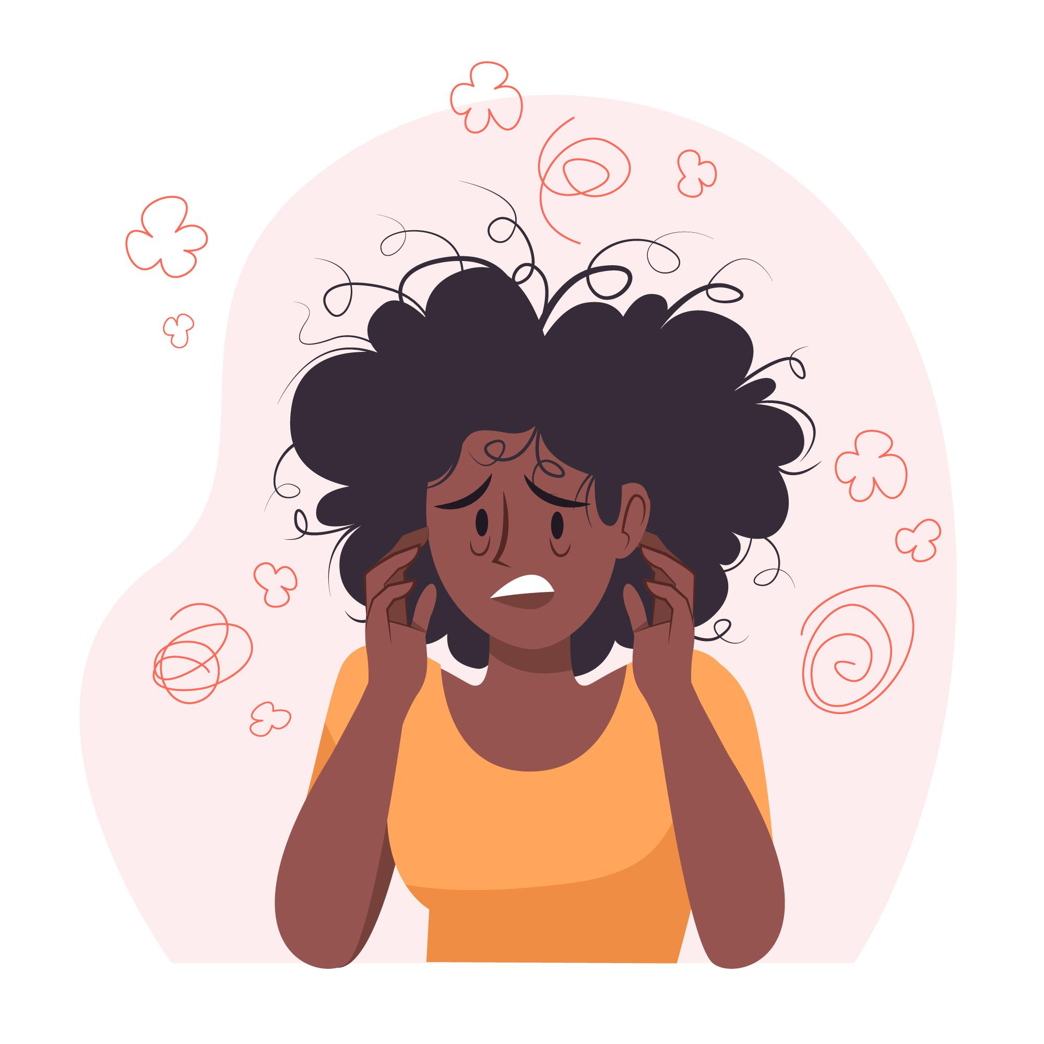

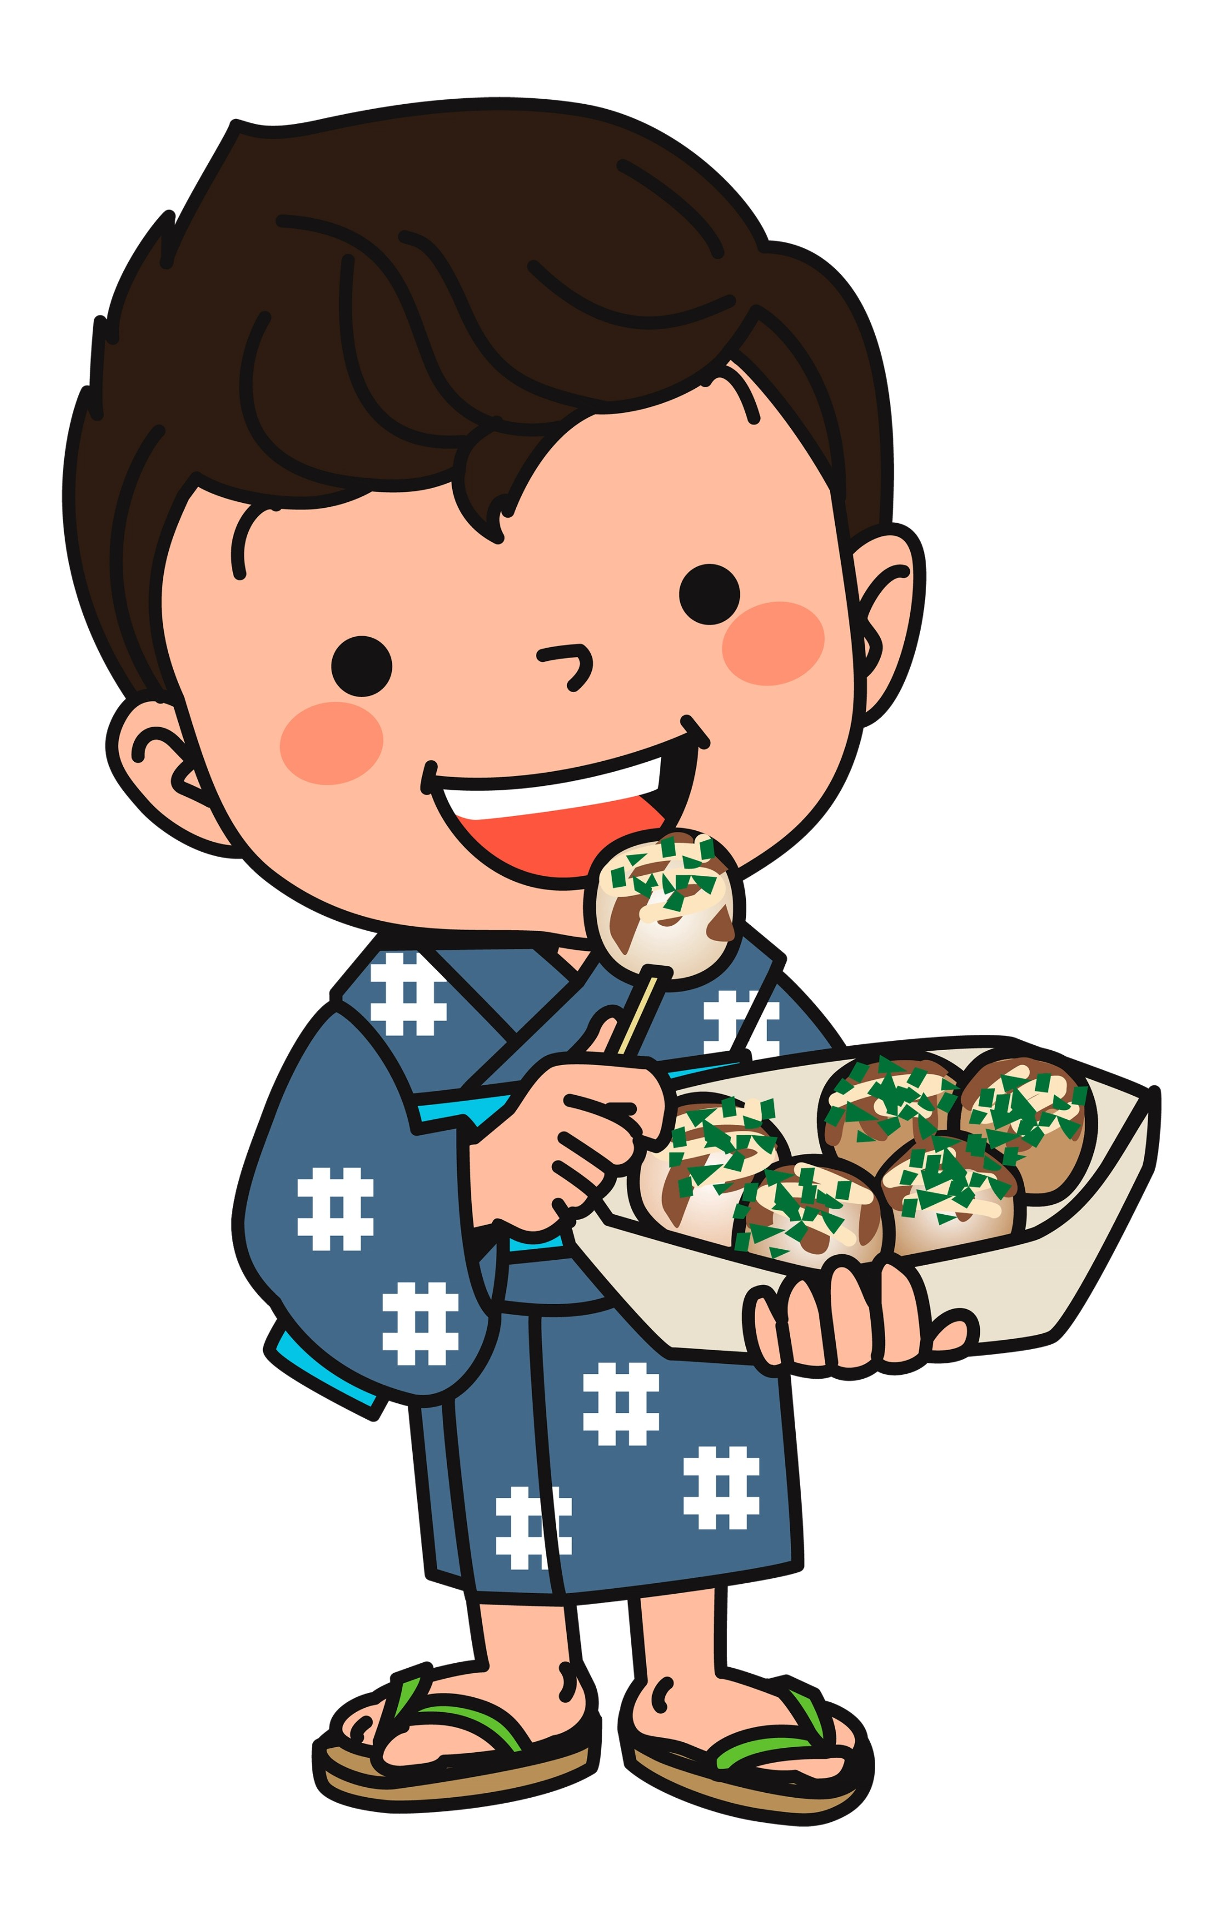

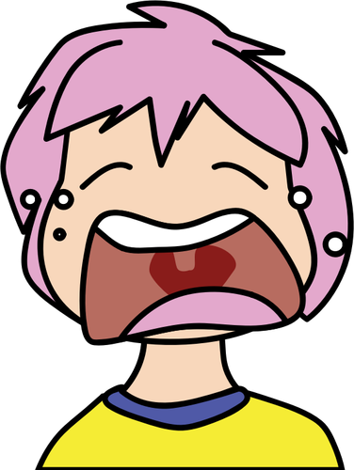

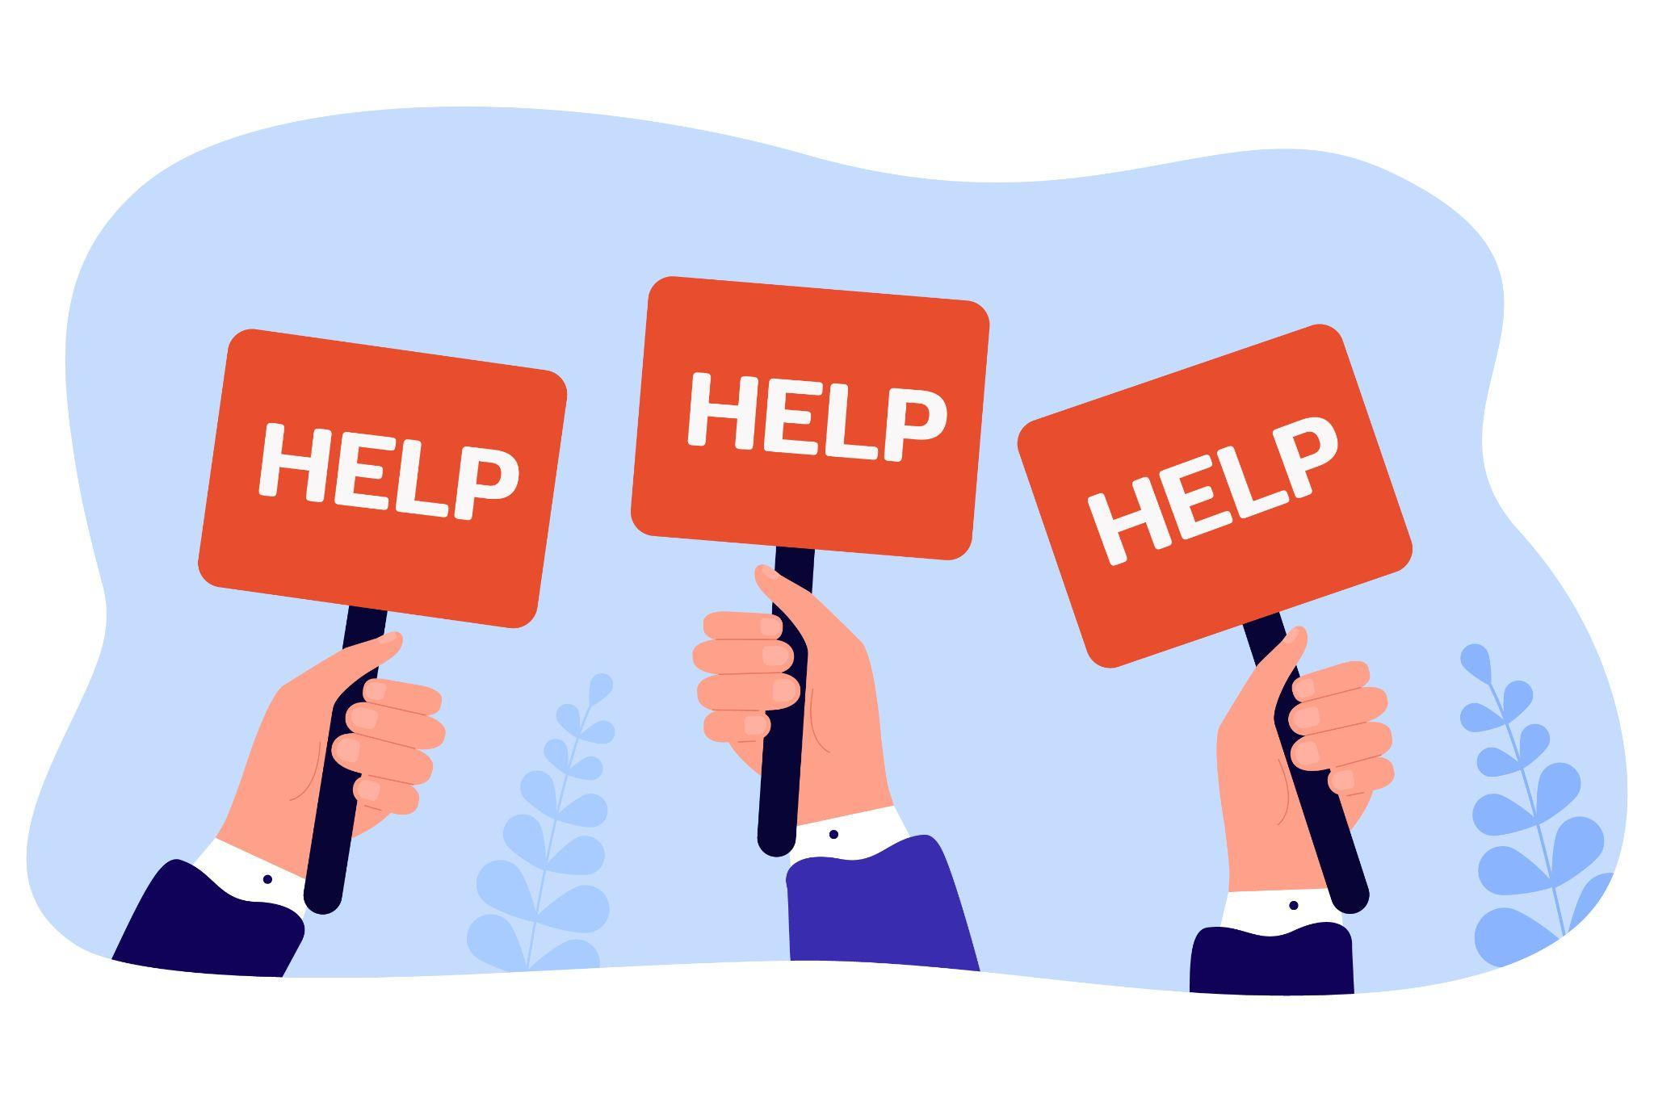
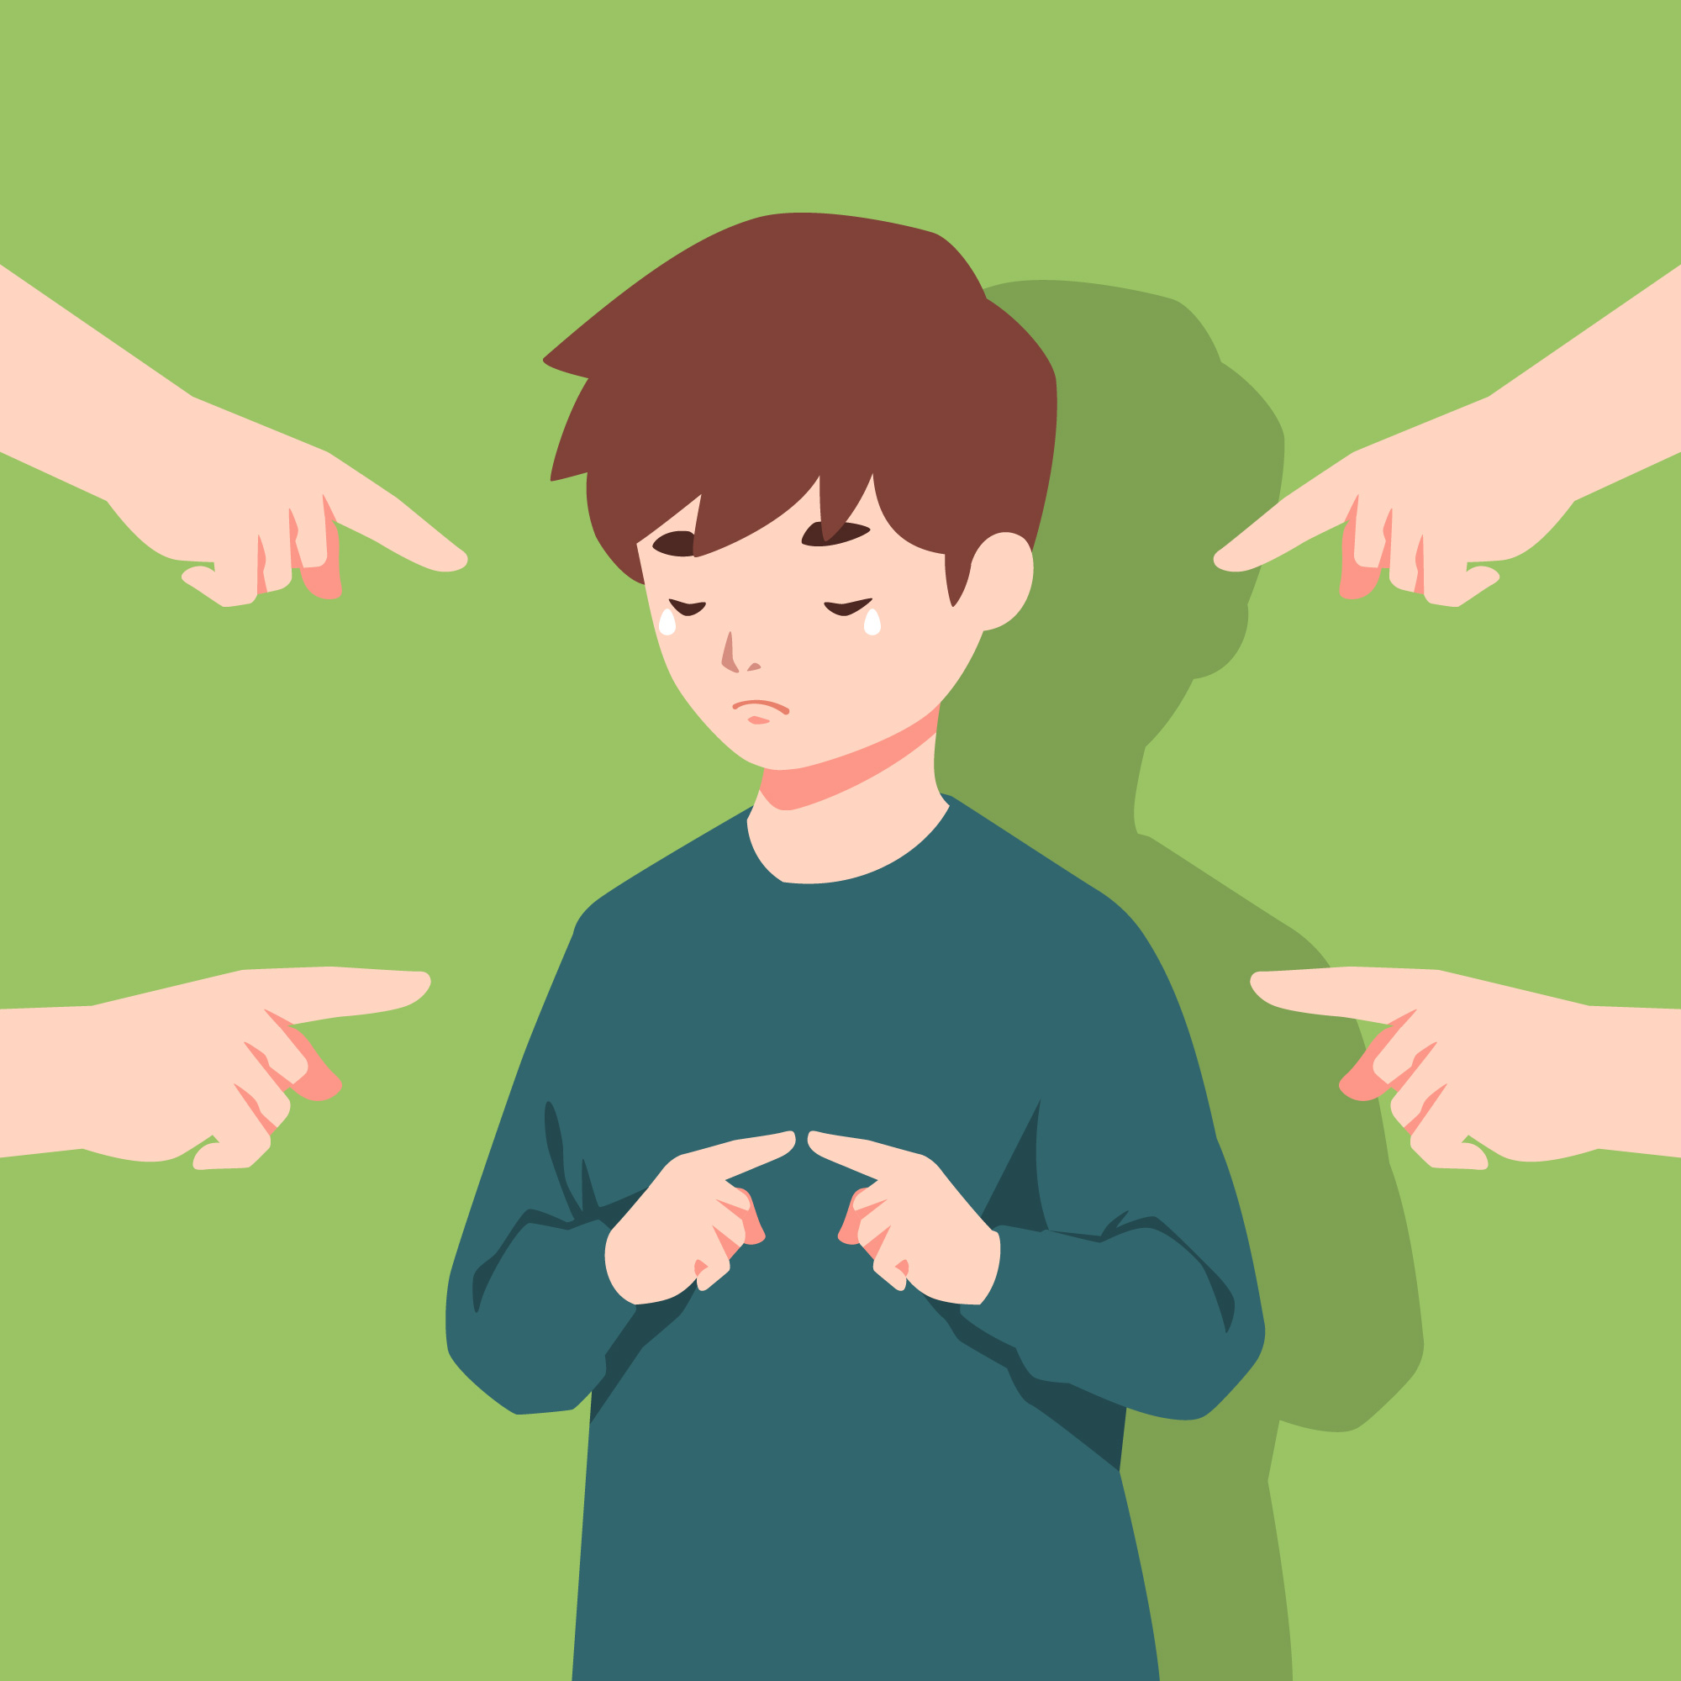
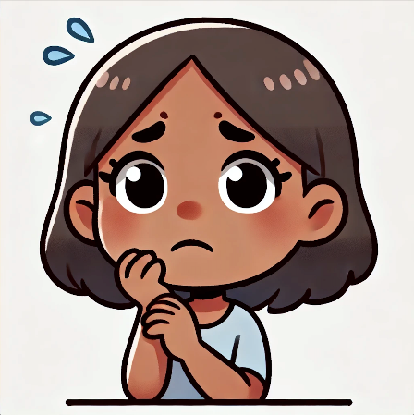
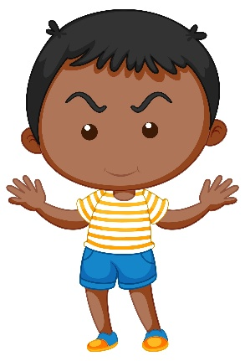
Choose a Sibling
1
2
3
4
5
6
7
8
9
10
Wrap-Up
Notes:
Tell the siblings, “Today we will be doing an activity where you’ll take turns choosing a sibling on the slide, and then we’ll discuss the question that appears.”
Tell the siblings, “We will also be talking about coping skills today. Before we get started, would someone define the term ‘coping skills’?” (Things we can do to manage difficult situations.)
Note to facilitators:
When the activity is over (when all prompts have been selected or before time runs out), click “Wrap-Up” to be brought to the slide on coping skills.
Reminder to take opportunities to validate sibling experiences and identify coping skills throughout the activity.

Slide 5

When was a time you felt scared?
Notes:
Safety Question
Ask a sibling to read the question out loud. Ask if any sibs would like to share. Encourage the sibs to talk to each other when possible.
If needed, prompts for discussion:
What kinds of things scare you?
How do you cope with feeling scared?
Do you feel scared at home? Why or why not?
Click on the home icon to return to the game slide.
Reminder to take opportunities to validate sibling experiences and identify coping skills.

Slide 6
When was a time you solved a problem on your own?
Notes:
Building-Self Esteem Question
Ask a sibling to read the question out loud. Ask if any sibs would like to share. Encourage the sibs to talk to each other when possible.
If needed, prompts for discussion:
Do you think you’re good at solving problems? Please explain your answer.
Some problems are hard to solve on our own. How do you know when it’s time to ask for help?
Who do you turn to when you need help solving a problem?
Do you think you’ll get better at problem solving as you get older? Why or why not?
Reminder to take opportunities to validate sibling experiences and identify coping skills.
Click on the home icon to return to the game slide.

Slide 7
What does your family argue about?
How does it start?
Notes:
Sibling Anxiety Question
Ask a sibling to read the question out loud. Ask if any sibs would like to share. Encourage the sibs to talk to each other when possible.
If needed, prompts for discussion:
Does it seem like your family argues more or less than other families? Please explain.
How do you feel when you get into an argument with someone in your family?
How do you calm down after an intense argument?
Do you and your sibling argue more than your friends and their siblings?
Reminder to take opportunities to validate sibling experiences and identify coping skills.
Click on the home icon to return to the game slide.

Slide 8
What is mealtime like at your house?
Notes:
Fair is Not Equal Question
Ask a sibling to read the question out loud. Ask if any sibs would like to share. Encourage the sibs to talk to each other when possible.
If needed, prompts for discussion:
Does your family eat together at the same time, or do people eat at different times?
Do you consider yourself or your sibling to be a picky eater? Please explain.
Are you and your sibling allowed to have phones/screens at the table? Why or why not?
If you have children when you are an adult, will you enforce rules at mealtime? Please explain.
Reminder to take opportunities to validate sibling experiences and identify coping skills.
Click on the home icon to return to the game slide.

Slide 9
When was a time you felt happy?
Notes:
Love/Hate Relationship Question
Ask a sibling to read the question out loud. Ask if any sibs would like to share. Encourage the sibs to talk to each other when possible.
If needed, prompts for discussion:
Does your family make you happy? Why or why not?
Do you ever feel like having a challenging sibling makes it harder for you to be happy? Please explain.
Describe a time you felt unhappy. How did you cope with it?
What kinds of things make you happy?
Reminder to take opportunities to validate sibling experiences and identify coping skills.
Click on the home icon to return to the game slide.

Slide 10
Has your family ever needed to get extra help for your sibling?
Tell us about it.
Notes:
Shame/Embarrassment Question
Ask a sibling to read the question out loud. Ask if any sibs would like to share. Encourage the sibs to talk to each other when possible.
If needed, prompts for discussion:
Is it okay to ask for help? Why or why not?
Does your sibling need extra help in school or with activities? How does that make you feel?
When you feel embarrassed, does your face get red? What else happens to you?
Reminder to take opportunities to validate sibling experiences and identify coping skills.
Click on the home icon to return to the game slide.

Slide 11
My parents don’t allow my sibling and me to be alone in the same room because my sibling has unpredictable behavior and my parents don’t want me to get hurt. Has anyone else had that experience?
Notes:
Sibling Aggression Question
Ask a sibling to read the question out loud. Ask if any sibs would like to share. Encourage the sibs to talk to each other when possible.
If needed, prompts for discussion:
Has your sibling ever hurt you, either on purpose or by accident? If so, explain how that made you feel.
What advice would you give to someone who is afraid their sibling might hurt them?
Is there an adult you feel comfortable talking to when you feel unsafe? If so, who is it?
Does home feel like a safe place or an unsafe place for you? Please explain.
Reminder to take opportunities to validate sibling experiences and identify coping skills.
Click on the home icon to return to the game slide.

Slide 12
When was a time you felt guilty?
Notes:
Sibling Guilt Question
Ask a sibling to read the question out loud. Ask if any sibs would like to share. Encourage the sibs to talk to each other when possible.
If needed, prompts for discussion:
Is it possible to feel guilty if you haven’t done anything wrong? Please explain.
Does saying sorry help you feel less guilty? Explain why or why not.
Have you ever been mean to your sibling? Explain how that made you feel.
Is it hard to forgive your sibling if they did something mean to you, even if they apologized? Please explain.
Reminder to take opportunities to validate sibling experiences and identify coping skills.
Click on the home icon to return to the game slide.

Slide 13
When was a time you felt very calm?
Notes:
Mindfulness Question
Ask a sibling to read the question out loud. Ask if any sibs would like to share. Encourage the sibs to talk to each other when possible.
If needed, prompts for discussion:
Describe a time when it was hard to calm down. How did that make you feel?
Does your sibling have a hard time staying calm? Why might that be?
What kinds of things do you do to calm down?
Do you feel more calm or less calm when you are separated from your sibling? Please explain.
Reminder to take opportunities to validate sibling experiences and identify coping skills.
Click on the home icon to return to the game slide.

Slide 14
When was a time you felt like breaking a rule?
Notes:
Family Rules Question
Ask a sibling to read the question out loud. Ask if any sibs would like to share. Encourage the sibs to talk to each other when possible.
If needed, prompts for discussion:
Do you think that rules should always be followed? Please explain.
Are some rules meant to be broken? Please explain.
Do you and your sibling follow different rules? If so, how do you feel about that?
Reminder to take opportunities to validate sibling experiences and identify coping skills.
Click on the home icon to return to the game slide.

Slide 15
Coping Skills: What Works for You?
Take deep breaths (breathe from your belly, not your chest)
Move your body (take a walk, stretch, exercise)
Read a good book
Watch a funny movie
Snuggle or play with a pet
Hug a stuffed animal or pillow
Take a bath or hot shower
Rip paper into small pieces
Write a letter to someone that you may never send
Journal (write about what you are struggling with)
Count to 10 slowly
Get a drink of water
Call an adult or friend
Draw or color
Listen to or play music
Walk away
Notes:
Tell the group, “We talked about coping skills in today’s group.”
Ask siblings to share the coping strategies that work for them.
Next, tell the group, “Now we want to share a list of coping skills that other siblings have told us about.”
The coping skills will appear one at a time when you hit the space bar.
Ask the group:
What coping skills have you tried that work for you?
What coping skills would you like to try after today’s group?
Are there any coping skills you use that aren’t on this list?
Go to next slide to wrap up the group.

Slide 16
Wrapping Up
What was your favorite part of today’s group?
What would you change to make the group better?
Notes:
Ask the siblings the questions on the slide. Allow them to respond verbally or in the chat feature. Record the responses.
Let the siblings know when the group will meet again and that they are always welcome to return.
Finally, remind siblings to complete the survey that we are sending to their parent/guardian’s email.
Tell them, “Your responses are important to us and help us improve the group!”
Thank the siblings for participating.

